Slide 1

Database Technologies - MySQL
A day without new knowledge is a lost day.
Before we start DBT module.
Which module(s) you have completed?
iet
If A and a, B and b, C and c etc. are treated in the same way then it is case-insensitive. MySQL is case-insensitive
In this module we are going to learn SQL, PL/SQL and NoSQL(MongoDB)

Slide 2
Introduction
Data Access Object (DAO)
If anyone who wants to develop a good application
then he should have the knowledge three major components.
They are . . . . .
(3-Tier Architecture).
Presentation Tier [ UI ]
Application Tier [ Server Application and Client Application ]
Data Layer / Data Access Layer [ Flat Files / RDBMS / NoSQL ]
So as a programmer:
a person should understand and be able to interact with a database is must, so than the data which is collected from the UI is processed and stored permanently. (eg. Any management systems, set top box, washing machine, mobile application etc.).
The term “front-end” refers to the user interface, while “back-end” means the server, application and database that work behind the scenes to deliver information to the user.

Slide 3
Introduction
Why do we need databases (Use Case)?
We need databases because they organize data in a manner which allows us to store, query, sort, and manipulate data in various ways. Databases allow us to do all this things.
Many companies collects data from different resource (like Weather data, Geographical data, Finance data, Scientific data, Transport data, Cultural data, etc.)

Slide 4
What is Relation and Relationship?

Slide 5
relation and relationship?
Relation (in Relational Algebra "R" stands for relation): In Database, a relation represents a table or an entity than contain attributes.
Relationship: In database, relationship is that how the two entities are connected to each other, i.e. what kind of relationship type they hold between them.
Primary/Foreign key is used to specify this relationship.
Remember:
Foreign Key is also know as
Reference
Referential key.
Note:
Table - The physical instantiation of a relation in the database schema.
Relation - A logical construct that organizes data into rows and columns.

Slide 6
File Systems is the traditional way to keep your data organized.
File System
vs
DBMS

Slide 7
file-oriented system
struct Employee {
int emp_no;
char emp_name[50];
int salary;
} emp[1000];
struct Employee {
int emp_no;
char emp_name[50];
int salary;
};
struct Employee emp[1000];
File Anomalies
c:\employee.txt
c:\employee.txt
c:\employee.txt
c:\employee.txt
c:\employee.txt
1 suraj 4000
2 ramesh 6000
3 rajan 4500
. |
. |
. |
500 sam 3500
. |
. |
. |
1000 amit 2300
1 suraj 4000
2 ramesh 6000
3 rajan 4500
. |
. |
. |
500 sam 3500
. |
. |
1000 amit 2300
. |
. |
. |
2000 jerry 4500
. |
. |
1 suraj 4000
2 ramesh 6000
3 rajan 4500
. |
. |
. |
500 pankaj 3500
. |
. |
1000 amit 2300
. |
1000 amit 2300
. |
2000 jerry 4500
. |
. |
1 suraj 4000
2 ramesh 6000
3 rajan 4500
. |
. |
. |
pankaj 500 3500
. |
. |
1000 amit 2300
. |
1000 amit 2300
. |
jerry 2000 4500
. |
. |
1 suraj 4000
2 ramesh 6000
3 rajan 4500
. |
. |
. |
500 sam 3500
. |
. |
. |
. |
. |
1250 neel 4500

Slide 8
Create/Open an existing file
Reading from file
Writing to a file
Closing a file
file-oriented system
File Anomalies
c:\employee.txt
file attributes
file permissions
search empl ID=1
search emp_name
1 suraj 4000
2 ramesh 6000
3 rajan 4500
. |
. |
. |
500 sam 3500
. |
. |
. |
1000 amit 2300
File Name
Type
Location
File permissions
Share permissions
1 suraj 4000
2 ramesh 6000
3 rajan 4500
. |
. |
. |
500 sam 3500
. |
. |
. |
1000 amit 2300
1 suraj 4000
2 ramesh 6000
3 rajan 4500
. |
. |
. |
500 sam 3500
. |
. |
. |
1000 amit 2300

Slide 9
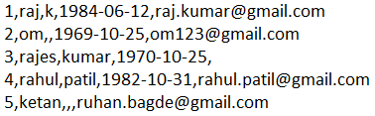
file-oriented system
A flat file database is a database that stores data in a plain text file (e.g. *.txt, *.csv, *.tsv etc. format). Each line of the text file holds one record, with fields separated by delimiters, such as commas or tabs.
1 rajan MG Road Pune MH 34500
2 rahul patil SSG Lane Pune MH 54000
3 suraj raj k Deccan Gymkhana Pune MH 22000
4, S M Kumar, Mg Road Pune MH, 32000
5, S M Kumar, Mg Road, Pune, MH, 32000
The Zen of Python,
Beautiful is better than ugly.
Explicit is better than implicit.
Simple is better than complex.
Complex is better than complicated.
Flat is better than nested.
Sparse is better than dense.
Readability counts.
Special cases aren't special enough to break the rules.
Although practicality beats purity.
Errors should never pass silently.
Unless explicitly silenced.
In the face of ambiguity, refuse the temptation to guess.
There should be one-- and preferably only one --obvious way to do it.
Although that way may not be obvious at first unless you're Dutch.
Now is better than never.
Although never is often better than *right* now.
If the implementation is hard to explain, it's a bad idea.
If the implementation is easy to explain, it may be a good idea.
Namespaces are one honking great idea -- let's do more of those!

Slide 10
advantages of file-oriented system
The biggest advantage of file-based storage is that anyone can understand the system.
Advantage of File-oriented system
Backup: It is possible to take faster and automatic back-up of database stored in files of computer-based systems.
Data retrieval: It is possible to retrieve data stored in files in easy and efficient way.
Editing: It is easy to edit any information stored in computers in form of files.
Remote access: In computer-based systems, it is possible to access data remotely.
Sharing: Data stored in files of computer-based systems can be shared among multiple users at a same time.

Slide 11
disadvantage of file-oriented system
The biggest disadvantage of file-based storage is as follows.
Disadvantage of File-oriented system
Data redundancy: It is possible that the same information may be duplicated in different files. This leads to data redundancy results in memory wastage. (Suppose a customer having both kind of accounts- saving and current account. In such a situation a customers detail are stored in both the file, saving.txt- file and current.txt- file , which leads to Data Redundancy.)
Data inconsistency: Because of data redundancy, it is possible that data may not be in consistent state. (Suppose customer changed his/her address. There might be a possibility that address is changed in only one file (saving.txt) and other (current.txt) remain unchanged.)
Limited data sharing: Data are scattered in various files and also different files may have different formats (for example: .txt, .csv, .tsv and .xml) and these files may be stored in different folders so, due to this it is difficult to share data among different applications.
Data Isolation: Because data are scattered in various files, and files may be in different formats (for example: .txt, .csv, .tsv and .xml), writing new application programs to retrieve the appropriate data is difficult.
Data security: Data should be secured from unauthorized access, for example a account holder in a bank should not be able to see the account details of another account holder, such kind of security constraints are difficult to apply in file processing systems.

Slide 12

Relation Schema: A relation schema represents name of the relation with its attributes.
e.g. student (roll_no, name, address, phone and age) is relation schema for STUDENT
DBMS
The database management system (DBMS) is the software that interacts with end users, applications, and the database itself to store and analyze the data.
database: Is the collection of related data which is organized, database can store and retrieve large amount of data easily, which is stored in one or more data files by one or more users, it is called as structured data.
management system: is a software, designed to define, manipulate, retrieve and manage data in a database.
A database is an organized collection of structured information.

Slide 13



relational database management system?
A RDBMS is a database management system (DBMS) that is based on the relational model introduced by Edgar Frank Codd at IBM in 1970.
RDBMS supports
client/server Technology
Highly Secured
Relationship (PK/FK)
A server is a computer program or device that provides a service to another computer program and its user, known as the client.
In the client/server programming model, a server program awaits and fulfills requests from client programs, which might be running in the same, or other computers.

Slide 14
relational model concepts
and
properties of relational table

Slide 15
relational model concepts
Relational model organizes data into one or more tables (or "relations") of columns and rows. Rows are also called records or tuples. Columns are also called attributes.
Tables − In relational model, relations are saved in the form of Tables. A table has rows and columns.
Attribute − Attributes are the properties that define a relation. e.g. (roll_no, name, address, phone and age)
Tuple − A single row of a table, which contains a single record for that relation is called a tuple.
Relation schema − A relation schema describes the relation name (table name) with its attribute (columns) names.
Attribute domain − Every attribute has some pre-defined datatypes, known as attribute domain.
Relation key − Each row has one or more attributes, known as relation key, which can identify the row in the relation (table) uniquely.
e.g. student(roll_no, name, address, phone and age) is relation schema for student relation.

Slide 16
properties of relational table
ID | job | firstName | DoB | salary
1 | manager | Saleel Bagde | yyyy-mm-dd | ●●●●●●
3 | salesman | Sharmin | yyyy-mm-dd | ●●●●●●
4 | accountant | Vrushali | yyyy-mm-dd | ●●●●●●
2 | salesman | Ruhan | yyyy-mm-dd | ●●●●●●
5 | 9500 | manager | yyyy-mm-dd | ●●●●●●
5 | Salesman | Rahul Patil | yyyy-mm-dd | ●●●●●●
Domain refers to all the valid values which a column may contain.
Relational tables have six properties:
Values are atomic.
Column values are of the same kind. (Attribute Domain: Every attribute has some pre-defined datatypes, known as attribute domain.)
Each row is unique.
The sequence of columns is insignificant – (unimportant).
The sequence of rows is insignificant – (unimportant).
Each attribute/column must have a unique name.

Slide 17

What is data?

Slide 18

what is data?
Data is any facts that can be stored and that can be processed by a computer.
Data can be in the form of Text or Multimedia
e.g.
number, characters, or symbol
images, audio, video, or signal

Slide 19
What is Entity Relationship Diagram?

Slide 20
Entity Relationship Diagram (ER Diagram)
Use E-R model to get a high-level graphical view to describe the "ENTITIES" and their "RELATIONSHIP"
The basic constructs/components of ER Model are
Entity, Attributes and Relationships.

Slide 21
An entity can be a real-world object.
What is Entity?

Slide 22
entity
In relation to a database , an entity is a
Person(student, teacher, employee, department, …)
Place(classroom, building, …) --a particular position or area
Thing(computer, lab equipment, …) --an object that is not named
Concept(course, batch, student’s attendance, …) -- an idea,
about which data can be stored. All these entities have some attributes or properties that give them their identity.
Every entity has its own characteristics.

Slide 23

When you are designing attributes for your entities, you will sometimes find that an attribute does not have a value. For example, you might want an attribute for a person's middle name, but you can't require a value because some people have no middle name. For these, you can define the attribute so that it can contain null values.
What is an Attribute?
Attributes are the properties that define a relation.
e.g. student(ID, firstName, middleName, lastName, city)
Entity
In some cases, you might not want a specific attribute to contain a null value, but you don't want to require that the user or program always provide a value. In this case, a default value might be appropriate. A default value is a value that applies to an attribute if no other valid value is available.
Attribute

Slide 24
attributes
A table has rows and columns
In RDBMS, a table organizes data in rows and columns. The COLUMNS are known as ATTRIBUTES / FIELDS whereas the ROWS are known as RECORDS / TUPLE.
In Relation: EMP
Attributes
ID | EmployeeName | Job | Hiredate | Salary
1 | KING | PRESIDENT | 2017-02-15 | 5000
… | … | … | … | …
… | … | … | … | …
… | … | … | … | …
Rows

Slide 25
attributes
In Entity Relationship(ER) Model attributes can be classified into the following types.
Simple/Atomic and Composite Attribute
Single Valued and Multi Valued attribute
Stored and Derived Attributes
Complex Attribute

Slide 26
attributes
Simple / Atomic Attribute --VS-- Composite Attribute
(Can’t be divided further) (Can be divided further)
Single Value Attribute --VS-- Multi Valued Attribute
(Only One value) (Multiple values)
Stored Attribute --VS-- Derived Attribute
(Only One value) (Virtual)
Complex Attribute
(Composite & Multivalued)
Atomic Attribute: An attribute that cannot be divided into smaller independent attribute is known as atomic attribute.
e.g. ID’s, age, gender, zip, marital status cannot further divide.
Single Value Attribute: An attribute that has only single value is known as single valued attribute.
e.g. manufactured part can have only one serial number, voter card, blood group, price, quantity, branch can have only one value.
Stored Attribute: The stored attribute are such attributes which are already stored in the database and from which the value of another attribute is derived.
e.g. (HRA, DA…) can be derive from salary, age can be derived from DoB, total marks or average marks of a student can be derived from marks.

Slide 27
Composite VS Multi Valued Attribute

Slide 28

composite / multi valued attributes
Composite Attribute
Person Entity
Name attribute: ( firstName, middleName, and lastName )
PhoneNumber attribute: ( countryCode, cityCode, and phoneNumber )
Multi Valued Attribute
Person Entity
Hobbies attribute: [ reading, hiking, hockey, skiing, photography, . . . ]
SpokenLanguages attribute: [ Hindi, Marathi, Gujarati, English, . . . ]
Degrees attribute: [ 10th , 12th, BE, ME, PhD, . . . ]
emailID attribute: [ saleel@gmail.com, salil@yahoomail.com, . . . ]

Slide 29
What is an Prime, Non-Prime Attribute?

Slide 30
attributes
Prime attribute (Entity integrity)
An attribute, which is a part of the prime-key (candidate key), is known as a prime attribute.
Non-prime attribute
An attribute, which is not a part of the prime-key (candidate key), is said to be a non-prime attribute.

Slide 31
Entity Relationship Diagram Symbols

Slide 32
erdplus.com
www.draw.io
entity relationship diagram symbols
Attribute
Composite Attribute
Key Attribute
Strong Entity
Weak Entity
Derived Attribute
Weak Relationship
Relationship
Multivalued Attribute

Slide 33
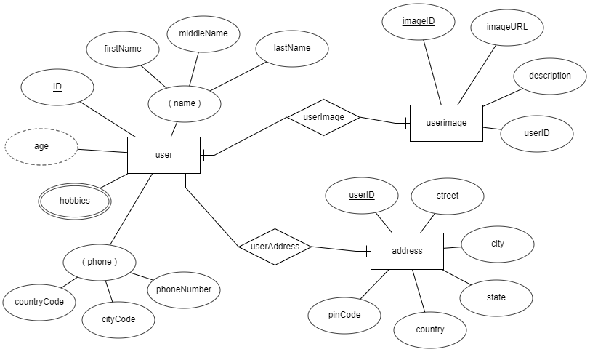
entity relationship diagram
DoB

Slide 34
What is a degree, cardinality, domain and union in database?
Degree d(R) / Arity: Total number of attributes/columns present in a relation/table is called degree of the relation and is denoted by d(R).
Cardinality |R|: Total number of tuples/rows present in a relation/table, is called cardinality of a relation and is denoted by |R|.
Domain: Total range of accepted values for an attribute of the relation is called the domain of the attribute. (Data Type)
Union Compatibility: Two relations R and S are set to be Union Compatible to each other if and only if:
They have the same degree d(R).
Domains of the respective attributes should also be same.

Slide 35
Data integrity refers to the correctness and completeness of data.
A domain constraint and types of data integrity constraints
Domain Constraint = data type + Constraints (not null/unique/primary key/foreign key/check/default)
e.g. custID INT, constraint pk_custid PRIMARY KEY(custID)
Three types of integrity constraints: entity integrity, referential integrity and domain integrity:
Entity integrity: Entity Integrity Constraint is used to ensure the uniqueness of each record the table. There are primarily two types of integrity constraints that help us in ensuring the uniqueness of each row, namely, UNIQUE constraint and PRIMARY KEY constraint.
Referential integrity: Referential Integrity Constraint ensures that there always exists a valid relationship between two tables. This makes sure that if a foreign key exists in a table relationship then it should always reference a corresponding value in the second table or it should be null.
Domain integrity: A domain is a set of values of the same type. For example, we can specify if a particular column can hold null values or not, if the values have to be unique or not, the data type or size of values that can be entered in the column, the default values for the column, etc..

Slide 36
what is a domain constraint in database?
Domain Constraint = data type + Constraints (NOT NULL / UNIQUE / PRIMARY KEY / FOREIGN KEY / CHECK / DEFAULT)
Data Domain refers to all the valid values which a column may contain and can be done by giving data type to the column.

Slide 37
Keys are used to establish relationships between tables and also to uniquely identify any record in the table.
types of Keys?
r = Employee(EmployeeID, FullName, job, salary, PAN, DateOfBirth, emailID, deptno)
Candidate Key: are individual columns in a table that qualifies for uniqueness of all the rows. Here in Employee table EmployeeID, PAN or emailID are Candidate keys.
Primary Key: is the columns you choose to maintain uniqueness in a table. Here in Employee table you can choose either EmployeeID, PAN or emailID columns, EmployeeID is preferable choice.
Alternate Key: Candidate column other the primary key column, like if EmployeeID is primary key then , PAN or emailID columns would be the Alternate key.
Super Key: If you add any other column to a primary key then it become a super key, like EmployeeID + FullName is a Super Key.
Composite Key: If a table do not have any single column that qualifies for a Candidate key, then you have to select 2 or more columns to make a row unique. Like if there is no EmployeeID, PAN or emailID columns, then you can make FullName + DateOfBirth as Composite key. But still there can be a narrow chance of duplicate row.

Slide 38
Degrees of relationship
The degree of relationship can be defined as the number of occurrences in one entity that is associated with the number of occurrences in another entity.

Slide 39

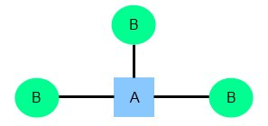
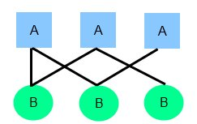
relationships
There are three degrees of relationship
one-to-one (1:1)
one-to-many (1:M)
many-to-many (M:N)

Slide 40
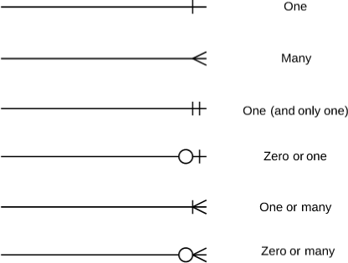
relationships

Slide 41
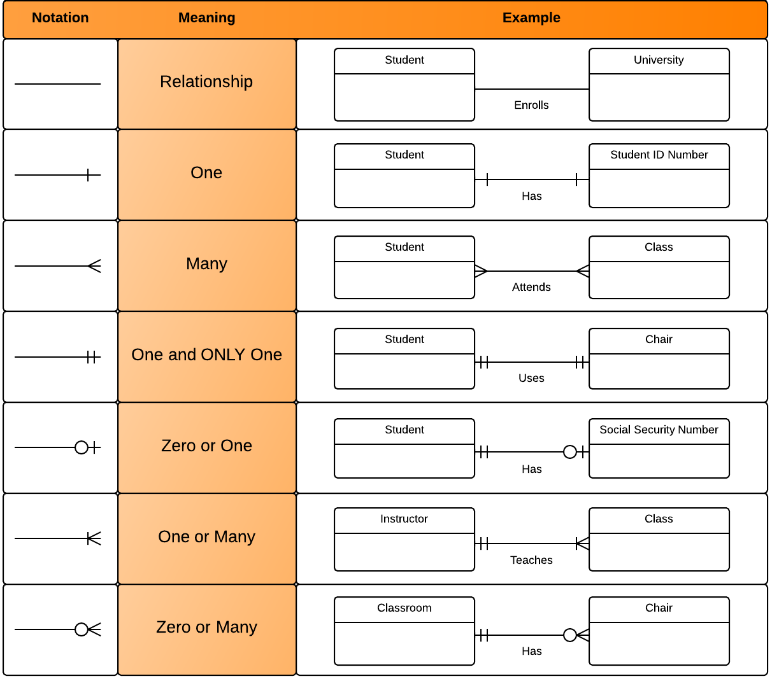
relationships

Slide 42
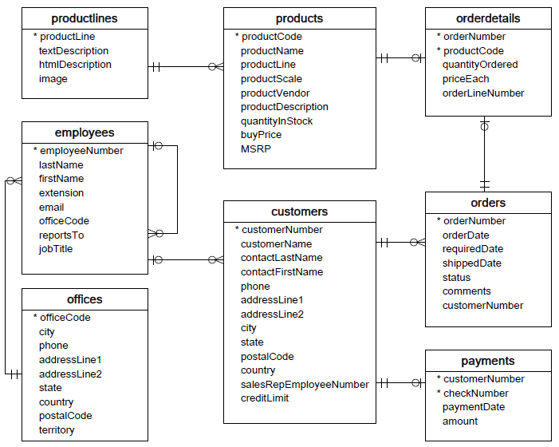

Slide 43
one-to-one relationship

Slide 44
one-to-one relationship
A one-to-one relationship between two tables means that a row in one table can only relate to zero/one row in the table on the other side of their relationship. This is the least common database relationship.
A one-to-one relationship is a type of cardinality that refers to the relationship between two entities R and S in which one element of entity R may only be linked to zero/one element of entity S, and vice versa.
Country
Capital
Country
Capital
Country
one-to-one relationship
Capital
Country
Capital
=
Country
Capital
Country
Capital

Slide 45
one-to-one relationship
A one-to-one relationship between two tables means that a row in one table can only relate to zero/one row in the table on the other side of their relationship. This is the least common database relationship.
A one-to-one relationship is a type of cardinality that refers to the relationship between two entities R and S in which one element of entity R may only be linked to zero/one element of entity S, and vice versa.
Person-1
Passport-1
Person-1
Passport-1
Person-2
Passport-1
Person-2
Passport-1
one-to-one relationship
=
Person-3
Passport-1
Person-4
Passport-1
Person-4

Slide 46
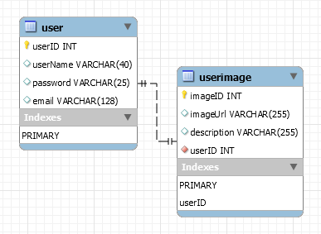
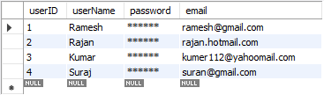
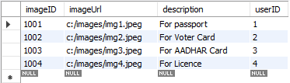
how to create one-to-one relationship
CREATE TABLE user (
userID INT PRIMARY KEY,
userName VARCHAR(40),
password VARCHAR(25),
email VARCHAR(128)
) ;
CREATE TABLE userImage (
imageID INT PRIMARY KEY,
imageUrl VARCHAR(255),
description VARCHAR(255),
userID INT NOT NULL UNIQUE,
FOREIGN KEY(UserID) REFERENCES user(userID)
) ;

Slide 47
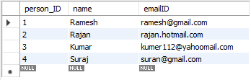

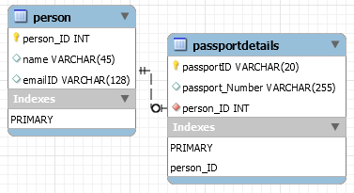
how to create one-to-one relationship
CREATE TABLE person (
person_ID INT PRIMARY KEY ,
name VARCHAR(45),
emailID VARCHAR(128)
);
CREATE TABLE passportDetails (
passportID VARCHAR(20) PRIMARY KEY,
passport_Number VARCHAR(255),
person_ID INT UNIQUE,
FOREIGN KEY(person_ID) REFERENCES person(person_ID)
);

Slide 48
one-to-many relationship

Slide 49
one-to-many relationship
A one-to-many relationship between two tables means that a row in one table can have zero or more row in the table on the other side of their relationship.
a one-to-many relationship is a type of cardinality that refers to the relationship between two entities R and S in which an element of R may be linked to many elements of S, but a member of S is linked to only one element of R.
Customer-1
Order-1
Customer-1
Order-1
Customer-2
Order-1
Customer-2
Order-1
one-to-many relationship
Customer-3
Order-2
=
Customer-2
Order-2
Customer-4
Order-1
Customer-3
Order-1
Customer-5
Order-2
Customer-3
Order-2
Order-3
Customer-3
Order-3
Order-1
Customer-4
Order-1

Slide 50
one-to-many relationship
A one-to-many relationship between two tables means that a row in one table can have one or more row in the table on the other side of their relationship.
a one-to-many relationship is a type of cardinality that refers to the relationship between two entities R and S in which an element of R may be linked to many elements of S, but a member of S is linked to only one element of R.
Invoice-1
Invoice_Item-1
Invoice-1
Invoice_Item-1
Invoice-2
Invoice_Item-1
Invoice-2
Invoice_Item-1
one-to-many relationship
Invoice-3
Invoice_Item-2
=
Invoice-2
Invoice_Item-2
Invoice-4
Invoice_Item-1
Invoice-3
Invoice_Item-1
Invoice_Item-2
Invoice-3
Invoice_Item-2
Invoice_Item-2
Invoice-3
Invoice_Item-3
Invoice_Item-1
Invoice-4
Invoice_Item-1

Slide 51
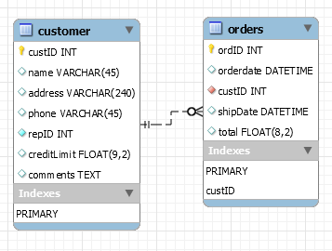
how to create one-to-many relationship
CREATE TABLE customer (
custID INT PRIMARY KEY,
name VARCHAR(45),
address VARCHAR(240),
phone VARCHAR(45),
repID INT NOT NULL,
creditLimit FLOAT(9,2),
comments TEXT,
constraint custid_zero CHECK(custID > 0)
);
CREATE TABLE orders (
ordID INT PRIMARY KEY,
orderdate DATETIME,
custID INT NOT NULL,
shipDate DATETIME,
total FLOAT(8,2),
FOREIGN KEY(custID) REFERENCES customer(custID),
constraint total_greater_zero CHECK(total >= 0)
);

Slide 52
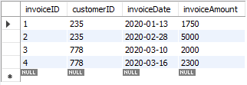
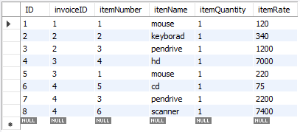
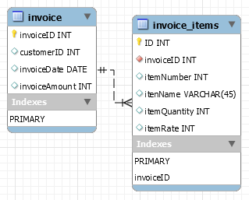
how to create one-to-many relationship
CREATE TABLE invoice (
invoiceID INT PRIMARY KEY,
customerID INT,
invoiceDate DATE,
invoiceAmount INT
);
CREATE TABLE invoice_items (
ID INT PRIMARY KEY,
invoiceID INT NOT NULL,
itemNumber INT,
itenName VARCHAR(45),
itemQuantity INT,
itemRate INT,
FOREIGN KEY(invoiceID) REFERENCES invoice(invoiceID)
);

Slide 53
many-to-one relationship

Slide 54
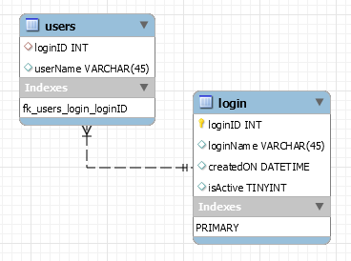
many-to-one relationship
CREATE TABLE users (
loginID INT,
userName VARCHAR(45),
constraint fk_users_login_loginID FOREIGN KEY(loginID) REFERENCES login(loginID)
);
CREATE TABLE login (
loginID INT,
loginName VARCHAR(45),
createdON DATETIME,
isActive TINYINT,
PRIMARY KEY(loginID)
);

Slide 55
many-to-many relationship

Slide 56
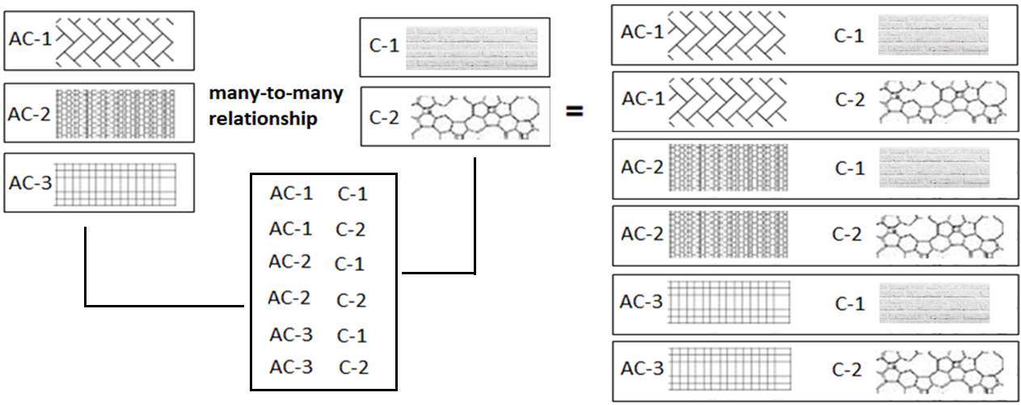
many-to-many relationship
A many-to-many relationship is a type of cardinality that refers to the relationship between two entities R and S in which R may contain a parent instance for which there are many children in S and vice versa.
=
=

Slide 57
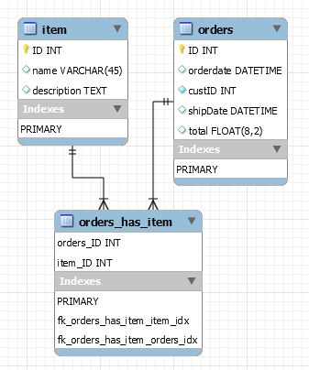
how to create many-to-many relationship
CREATE TABLE item (
item_ID INT PRIMARY KEY,
name VARCHAR(45),
description TEXT
);
CREATE TABLE orders (
orders_ID INT PRIMARY KEY,
orderdate DATETIME,
custID INT NOT NULL,
shipDate DATETIME,
total FLOAT(8,2),
constraint total_greater_zero CHECK(total >= 0)
);
CREATE TABLE orders_has_item (
orders_ID INT NOT NULL,
item_ID INT NOT NULL,
PRIMARY KEY(orders_ID, item_ID),
constraint fk_orders_has_item_orders FOREIGN KEY(orders_ID)
REFERENCES orders(ID),
constraint fk_orders_has_item_item1 FOREIGN KEY(item_ID)
REFERENCES item(ID)
);

Slide 58
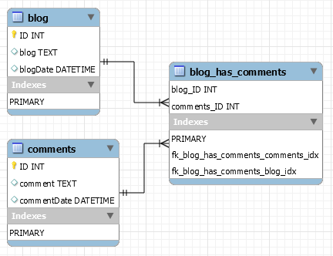
how to create many-to-many relationship
CREATE TABLE blog (
ID INT PRIMARY KEY,
blog TEXT,
blogDate DATETIME
);
CREATE TABLE comments (
ID INT PRIMARY KEY,
comment TEXT,
commentDate DATETIME
);
CREATE TABLE blog_has_comments (
blog_ID INT,
comments_ID INT,
PRIMARY KEY(blog_ID, comments_ID),
constraint fk_blog_has_comments_blog FOREIGN KEY(blog_ID) REFERENCES blog(ID),
constraint fk_blog_has_comments_comments FOREIGN KEY(comments_ID) REFERENCES comments(ID)
);

Slide 59

MySQL
MySQL is the most popular Open Source
Relational Database Management System.
MySQL was created by a Swedish company - MySQL AB that was founded in 1995. It was acquired by Sun Microsystems in 2008; Sun was in turn acquired by Oracle Corporation in 2010.
When you use MySQL, you’re actually using at least two programmes. One program is the MySQL server (mysqld.exe) and other program is MySQL client program (mysql.exe) that connects to the database server.

Slide 60
What is SQL?

Slide 61

what is sql?
SQL (Structured Query Language) is a database language designed and developed for managing data in relational database management systems (RDBMS). SQL is common language for all Relational Databases.

Slide 62
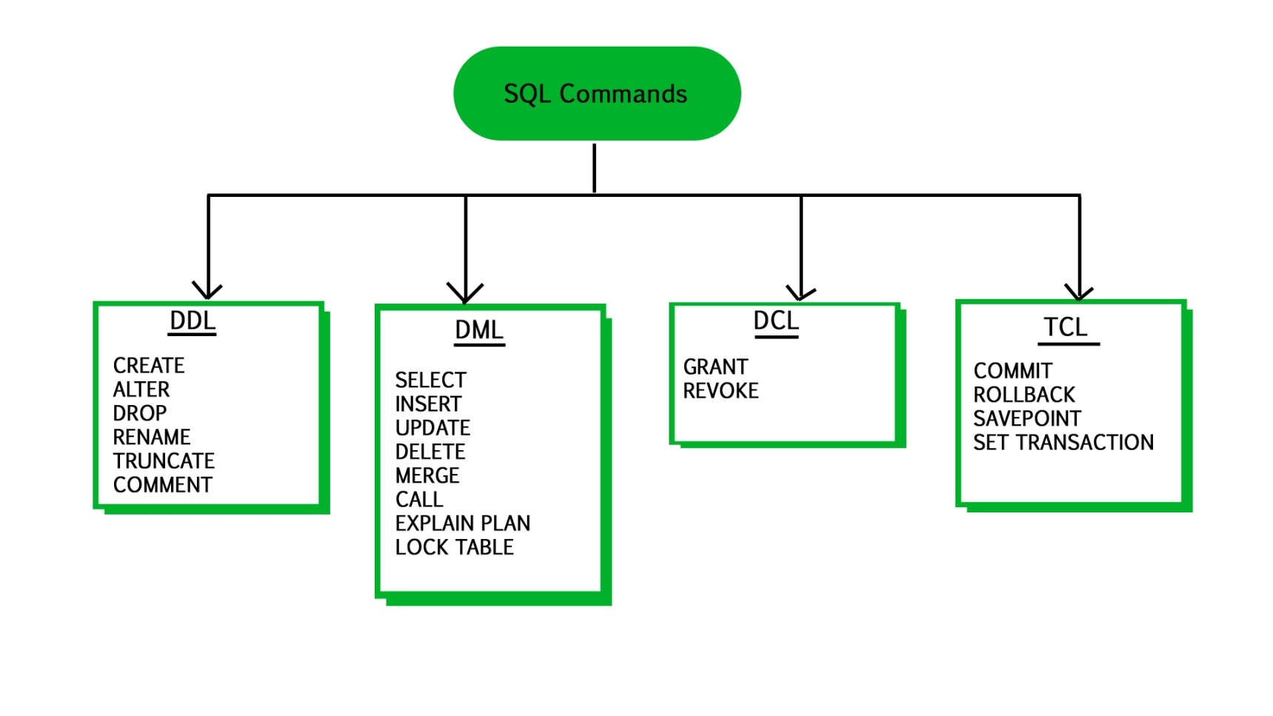
what is sql?
Note:
Explicit or implicit commit will commit the data.
Remember:
A NULL value is not treated as a blank or 0. Null or NULL is a special marker used in Structured Query Language to indicate that a data value does not exist in the database.
Degree d(R): Total no. of attributes/columns present in a relation/table is called degree of the relation and is denoted by d(R).
Cardinality |R|: Total no. of tuples present in a relation or Rows present in a table, is called cardinality of a relation and is denoted by |R|.

Slide 63
comments in mysql
From a # character to the end of the line.
From a -- sequence to the end of the line.
From a /* sequence to the following */ sequence.
Reconnect to the server | \r
Execute a system shell command | \!
Exit mysql | \q

Slide 64
Login to MySQL

Slide 65
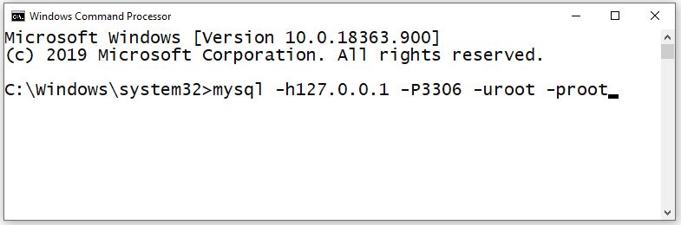
login
Default port for MySQL Server: 3306
C:\> mysql -hlocalhost -P3307 -uroot -p
C:\> mysql -h127.0.0.1 -P3307 -uroot -p [database_name]
C:\> mysql -h192.168.100.14 -P3307 -uroot -psaleel [database_name]
C:\> mysql --host localhost --port 3306 --user root --password=ROOT [database_name]
C:\> mysql --host=localhost --port=3306 --user=root --password=ROOT [database_name]

Slide 66
SHOW DATABASES

Slide 67
SHOW DATABASES Syntax
SHOW {DATABASES | SCHEMAS} [LIKE 'pattern' | WHERE expr]
SHOW SCHEMAS is a synonym for SHOW DATABASES.
SHOW DATABASES;
SHOW SCHEMAS;
SHOW DATABASES LIKE 'U%';
SHOW SCHEMAS LIKE 'U%';
NULL means “no database is selected”. Issue the USE dbName command to select the database.

Slide 68
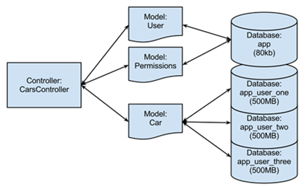
USE DATABASES
The USE db_name statement tells MySQL to use the db_name database as the default (current) database for subsequent statements. The database remains the default until the end of the session or another USE statement is issued.

Slide 69
USE DATABASES Syntax
USE db_name
\U db_name
Note:
USE, does not require a semicolon.
USE must be followed by a database name.
USE db1
\U db1

Slide 70
CREATE DATABASE

Slide 71
create database
CREATE DATABASE creates a database with the given name. To use this statement, you need the CREATE privilege for the database.
CREATE {DATABASE | SCHEMA} [IF NOT EXISTS] db_name
CREATE SCHEMA is a synonym for CREATE DATABASE.
CREATE DATABASE db1;
CREATE DATABASE IF NOT EXISTS db1;

Slide 72
DROP DATABASE
If the default database is dropped, the default database is unset (the DATABASE() function returns NULL).

Slide 73
drop database
DROP DATABASE drops all tables in the database and deletes the database. Be very careful with this statement! To use DROP DATABASE, you need the DROP privilege on the database.
DROP {DATABASE | SCHEMA} [IF EXISTS] db_name
DROP SCHEMA is a synonym for DROP DATABASE.
DROP DATABASE db1;
DROP DATABASE IF EXISTS db1;

Slide 74
Source Command

Slide 75
Source command
You can execute an SQL script file using the source command or \. command
\. file_name
source file_name
\. 'D:\mysqldemobld7.sql'
SOURCE 'D:\mysqldemobld7.sql'
SOURCE //infoserver1/infodomain1/Everyone/DBT/mysqldemobld7.sql

Slide 76
SHOW TABLES

Slide 77
SHOW TABLES Syntax
SHOW [FULL] TABLES

Slide 78
The char is a fixed-length character data type,
The varchar is a variable-length character data type.
CREATE TABLE temp (c1 CHAR(10), c2 VARCHAR(10));
INSERT INTO temp VALUES('SALEEL', 'SALEEL');
SELECT * FROM temp WHERE c1 LIKE 'SALEEL';
CREATE TABLE `123` (c1 INT, c2 VARCHAR(10));
datatypes
ENAME CHAR (10) | S | A | L | E | E | L |  |  |  |  | LENGTH -> 10
ENAME VARCHAR2(10) | S | A | L | E | E | L |  |  |  |  | LENGTH -> 6
When CHAR values are retrieved, the trailing spaces are removed (unless the PAD_CHAR_TO_FULL_LENGTHSQL mode is enabled)
In MySQL
ENAME CHAR (10) | S | A | L | E | E | L |  |  |  |  | LENGTH -> 6
ENAME VARCHAR(10) | S | A | L | E | E | L |  |  |  |  | LENGTH -> 6

Slide 79
datatype - string
Datatypes | Size | Description
CHAR [(length)] | 0-255
VARCHAR (length) | 0 to 65,535 | The maximum row size (65,535 bytes, which is shared among all columns.
TINYTEXT [(length)] | (2⁸ − 1) bytes
TEXT [(length)] | (2¹⁶ -1) bytes | 65,535 bytes ~ 64kb
MEDIUMTEXT [(length)] | (2²⁴ -1) bytes | 16,777,215 bytes ~16MB
LONGTEXT [(length)] | (2³² -1) bytes | 4,294,967,295 bytes ~4GB
ENUM('value1', 'value2',...) | 65,535 members
SET('value1', 'value2',...) | 64 members
BINARY[(length)] | 255
VARBINARY(length)
By default, trailing spaces are trimmed from CHAR column values on retrieval. If PAD_CHAR_TO_FULL_LENGTH is enabled, trimming does not occur and retrieved CHAR values are padded to their full length.
SET sql_mode = '';
SET sql_mode = 'PAD_CHAR_TO_FULL_LENGTH';

Slide 80
example of char and varchar
Datatypes | Size | Description
CHAR [(length)] | 0-255
VARCHAR (length) | 0 to 65,535 | The maximum row size (65,535 bytes, which is shared among all columns.
In CHAR, if a table contains value 'a', an attempt to store 'a ' causes a duplicate-key error.
Try Out
CREATE TABLE x (x1 CHAR(4), x2 VARCHAR(4));
INSERT INTO x VALUE('', '');
INSERT INTO x VALUE('ab', 'ab');
INSERT INTO x VALUE('abcd', 'abcd');
SELECT x1, LENGTH(x1), x2, LENGTH(x2) FROM x;
SET sql_mode = 'PAD_CHAR_TO_FULL_LENGTH';
SELECT x1, LENGTH(x1), x2, LENGTH(x2) FROM x;
SET sql_mode = '';
SELECT x1, LENGTH(x1), x2, LENGTH(x2) FROM x;
CREATE TABLE x (x1 CHAR(4) PRIMARY KEY, x2 VARCHAR(4));
INSERT INTO x VALUE('a', 'a');
INSERT INTO x VALUE('a ', 'a ');
CREATE TABLE x (x1 CHAR(4), x2 VARCHAR(4) PRIMARY KEY);
INSERT INTO x VALUE('a', 'a');
INSERT INTO x VALUE('a ', 'a ');

Slide 81
datatype - numeric
Datatypes | Size | Description
TINYINT | 1 byte | -128 to +127 (The unsigned range is 0 to 255).
SMALLINT [(length)] | 2 bytes | -32768 to 32767. (The unsigned range is 0 to 65535).
MEDIUMINT [(length)] | 3 bytes | -8388608 to 8388607. (The unsigned range is 0 to 16777215).
INT, INTEGER [(length)] | 4 bytes | -2147483648 to 2147483647. (The unsigned range is 0 to 4294967295).
BIGINT [(length)] | 8 bytes | -9,223,372,036,854,775,808 to 9,223,372,036,854,775,807
FLOAT [(length[,decimals])] | 4 bytes | FLOAT(255,30)
DOUBLE [PRECISION] [(length[,decimals])], REAL [(length[,decimals])] | 8 bytes | REAL(255,30) / DOUBLE(255,30) REAL will get converted to DOUBLE
DECIMAL [(length[,decimals])], NUMERIC [(length[,decimals])] |  | DECIMAL(65,30) / NUMERIC(65,30) NUMERIC will get converted in DECIMAL
For: float(M,D), double(M,D) or decimal(M,D), M must be >= D
Here, (M,D) means than values can be stored with up to M digits in total, of which D digits may be after the decimal point.
UNSIGNED prohibits negative values.

Slide 82
datatype – date and time
Datatypes | Size | Description
YEAR | 1 byte | YYYY
DATE | 3 bytes | YYYY-MM-DD
TIME | 3 bytes | HH:MM:SS
DATETIME | 8 bytes | YYYY-MM-DD hh:mm:ss

Slide 83
Use a CREATE TABLE statement to specify the layout of your table.
CREATE TABLE `123` (c1 INT, c2 VARCHAR(10));
create table
Use a CREATE TABLE statement to specify the layout of your table.
Remember:
by default, tables are created in the default database, using the InnoDB storage engine.
error occurs if the table exists.
error occurs if there is no default database.
error occurs if the database does not exist.
Note:
Table names are stored in lowercase on disk. MySQL converts all table names to lowercase on storage. This behavior also applies to database names and table aliases.
e.g. show variables like 'lower_case_table_names';

Slide 84
create table
syntax
e.g.
CREATE TABLE student (
ID INT,
firstName VARCHAR(45),
lastName VARCHAR(45),
DoB DATE,
emailID VARCHAR(128)
);
CREATE [TEMPORARY] TABLE [IF NOT EXISTS] tbl_name
(create_defineation, . . .)
[table_options]
[partition_options]
create_definition:
col_name column_definition
column_definition:
data_type [NOT NULL | NULL] [DEFAULT default_value]
[AUTO_INCREMENT] [UNIQUE [KEY] | [PRIMARY] KEY]
[reference_definition]
| data_type [GENERATED ALWAYS] AS (expression) [VIRTUAL]
[VISIBLE | INVISIBLE]
table_options:
ENGINE [=] engine_name
show engines;
set default_storage_engine = memory;

Slide 85
default value
The DEFAULT specifies a default value for the column.

Slide 86

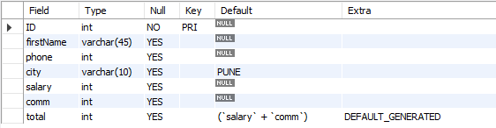
default value
col_name data_type DEFAULT value
The DEFAULT specifies a default value for the column.
CREATE TABLE posts (
postID INT,
postTitle VARCHAR(255),
postDate DATETIME DEFAULT NOW(),
deleted INT
);
# version 8.0 and above.
CREATE TABLE empl (
ID INT PRIMARY KEY,
firstName VARCHAR(45),
phone INT,
city VARCHAR(10) DEFAULT 'PUNE',
salary INT,
comm INT,
total INT DEFAULT(salary + comm)
);

Slide 87
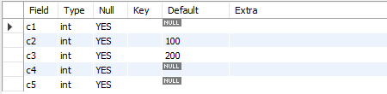
default value
The DEFAULT example.
CREATE TABLE temp (
c1 INT,
c2 INT DEFAULT 100,
c3 INT DEFAULT 200,
c4 INT,
c5 INT
);
INSERT INTO temp VALUES();
INSERT INTO temp VALUES(1, DEFAULT, DEFAULT, 1, 1);
INSERT INTO temp VALUES(2, DEFAULT(c2), DEFAULT(c3), 2, 2);
INSERT INTO temp VALUES(3, DEFAULT(c3), DEFAULT(c2), 3, 3);

Slide 88
Note:
Your database table has X columns, Where as the VALUES you are passing are for (X-1) or (X+1). This mismatch of column-values will giving you the error.
Inserting a string into a string column (CHAR, VARCHAR, TEXT, or BLOB) that exceeds the column maximum length. The value is truncated to the column maximum length.
insert rows
INSERT command inserts new rows into an existing table.
You can insert data using following methods:
INSERT ... VALUES
INSERT ... SET
INSERT ... SELECT

Slide 89
insert rows using values

Slide 90
dml- insert … values
INSERT inserts new rows into an existing table. The INSERT ... VALUES
INSERT [IGNORE] [INTO] tbl_name [PARTITION (partition_name [, partition_name] ...)] [ (col_name, . . .) ] { VALUES | VALUE } ( { expr | DEFAULT }, . . .), (. . .), . . . [ ON DUPLICATE KEY UPDATE assignment_list ]
The affected-rows value for an INSERT can be obtained using the ROW_COUNT() function.
Column Values
Column List
Inserting multiple rows

Slide 91
dml- insert … values
INSERT inserts new rows into an existing table. The INSERT ... VALUES
INSERT [IGNORE] [INTO] tbl_name [PARTITION (partition_name [, partition_name] ...)] [ (col_name, . . .) ] { VALUES | VALU E } ( { expr | DEFAULT }, . . .), (. . .), . . . [ ON DUPLICATE KEY UPDATE assignment_list ]
CREATE TABLE student (
ID INT PRIMARY KEY,
nameFirst VARCHAR(45),
nameLast VARCHAR(45),
DoB DATE ,
emailID VARCHAR(128)
);
e.g.
INSERT INTO student VALUES (29, 'sharmin', 'patil', '1999-11-10', 'sharmin.patil@gmail.com');
INSERT INTO student (ID, nameFirst, nameLast, DOB, emailID) VALUES (30, 'john', 'thomas', '1983-11-10', 'john.thomas@gmail.com' );
INSERT INTO student (ID, nameFirst, emailID) VALUES (31, 'jack', 'jack.thorn@gmail.com');
INSERT INTO student (ID, nameFirst) VALUES (32, 'james'), (33, 'jr. james'), (34, 'sr. james');

Slide 92
ORDER BY in UPDATE: if the table contains two values 1 and 2 in the id column and 1 is updated to 2 before 2 is updated to 3, an error occurs. To avoid this problem, add an ORDER BY clause to cause the rows with larger id values to be updated before those with smaller values.
In a SET statement, = is treated identically to :=
single-table update

Slide 93
single-table update
The UPDATE statement updates columns of existing rows in the named table with new values. The SET clause indicates which columns to modify and the values they should be given. The WHERE clause, if given, specifies the conditions that identify which rows to update. With no WHERE clause, all rows are updated. If the ORDER BY clause is specified, the rows are updated in the order that is specified. The LIMIT clause places a limit on the number of rows that can be updated.
UPDATE tbl_name SET col_name1 = { expr1 | DEFAULT } [, col_name2 = { expr2 | DEFAULT } ] . . .
[WHERE where_condition]
[ORDER BY . . .]
[LIMIT row_count]
UPDATE temp SET dname = 'new_value' LIMIT 2;
UPDATE temp SET c1 = 'new_value' ORDER BY loc LIMIT 2;
UPDATE temp SET c1 := 'new_value' WHERE deptno < 50;
UPDATE temp SET c1 := 'new_value' WHERE deptno < 50 LIMIT 2;
ALTER TABLE dept ADD SUMSALARY INT;
UPDATE dept SET sumsalary = (SELECT SUM(sal) FROM emp WHERE emp.deptno = dept.deptno GROUP BY emp.deptno);
UPDATE duplicate SET id = ( SELECT @cnt := @cnt + 1 );

Slide 94
single-table delete

Slide 95
single-table delete
The DELETE statement deletes rows from tbl_name and returns the number of deleted rows. To check the number of deleted rows, call the ROW_COUNT() function. The optional WHERE clause identify which rows to delete. With no WHERE clause, all rows are deleted. If the ORDER BY clause is specified, the rows are deleted in the order that is specified. The LIMIT clause places a limit on the number of rows that can be deleted.
DELETE FROM tbl_name
[PARTITION (partition_name [, partition_name] . . .)]
[WHERE where_condition]
[ORDER BY . . .]
[LIMIT row_count]
Note:
LIMIT clauses apply to single-table deletes, but not multi-table deletes.

Slide 96
auto_increment column
The AUTO_INCREMENT attribute can be used to generate a unique number/identity for new rows.

Slide 97
auto_increment
IDENTITY is a synonym to the LAST_INSERT_ID variable.
col_name data_type AUTO_INCREMENT [UNIQUE [KEY] | [PRIMARY] KEY]
Remember:
There can be only one AUTO_INCREMENT column per table.
it must be indexed.
it cannot have a DEFAULT value.
it works properly only if it contains only positive values.
It applies only to integer and floating-point types.
when you insert a value of NULL or 0 into AUTO_INCREMENT column, it generates next value.
use LAST_INSERT_ID() function to find the row that contains the most recent AUTO_INCREMENT value.

Slide 98
CREATE TABLE . . . LIKE . . ., the destination table preserves generated column information from the original table.
CREATE TABLE . . . SELECT . . ., the destination table does not preserves generated column information from the original table.
generated column
Remember:
Stored functions and user-defined functions are not permitted.
Stored procedure and function parameters are not permitted.
Variables (system variables, user-defined variables, and stored program local variables) are not permitted.
Subqueries are not permitted.
The AUTO_INCREMENT attribute cannot be used in a generated column definition.
Triggers cannot use NEW.COL_NAME or use OLD.COL_NAME to refer to generated columns.
Note:
The expression can contain literals, built-in functions with no parameters, operators, or references to any column within the same table. If you use a function, it must be scalar and deterministic.

Slide 99
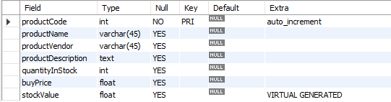
virtual column - generated always
col_name data_type [GENERATED ALWAYS] AS (expression) [VIRTUAL | STORED]
VIRTUAL: Column values are not stored, but are evaluated when rows are read, immediately after any BEFORE triggers. A virtual column takes no storage.
STORED: Column values are evaluated and stored when rows are inserted or updated. A stored column does require storage space and can be indexed.
Note:
The default is VIRTUAL if neither keyword is specified.
CREATE TABLE product(
productCode INT AUTO_INCREMENT PRIMARY KEY,
productName VARCHAR(45),
productVendor VARCHAR(45),
productDescription TEXT,
quantityInStock INT,
buyPrice FLOAT,
stockValue FLOAT GENERATED ALWAYS AS(quantityInStock * buyPrice) VIRTUAL
);

Slide 100
visible / invisible columns
Columns are visible by default. To explicitly specify visibility for a new column, use a VISIBLE or INVISIBLE keyword as part of the column definition for CREATE TABLE or ALTER TABLE.
Note:
An invisible column is normally hidden to queries, but can be accessed if explicitly referenced. Prior to MySQL 8.0.23, all columns are visible.
A table must have at least one visible column. Attempting to make all columns invisible produces an error.
SELECT * does not include invisible columns.

Slide 101
invisible column
col_name data_type INVISIBLE
CREATE TABLE employee (
ID INT AUTO_INCREMENT PRIMARY KEY,
firstName VARCHAR(40),
salary INT,
commission INT,
total INT DEFAULT(salary + commission) INVISIBLE
) ;
CREATE TABLE employee (
ID INT PRIMARY KEY AUTO_INCREMENT INVISIBLE ,
firstName VARCHAR(40)
) ;
ALTER TABLE employee MODIFY total INT VISIBLE;
ALTER TABLE employee MODIFY total INT INVISIBLE;
INSERT INTO employee (firstName, salary, commission) VALUES('ram', 4700, -700);
INSERT INTO employee (firstName, salary, commission) VALUES('pankaj', 3400, NULL);
INSERT INTO employee (firstName, salary, commission) VALUES('rajan', 3200, 250);
INSERT INTO employee (firstName, salary, commission) VALUES('ninad', 2600, 0);
INSERT INTO employee (firstName, salary, commission) VALUES('omkar', 4500, 300);
SELECT * FROM employee;

Slide 102
varbinary column
TODO
Note:
TODO
TODO
TODO

Slide 103
varbinary column
col_name VARBINARY
CREATE TABLE login (
ID INT AUTO_INCREMENT PRIMARY KEY,
userName VARCHAR(40),
password VARBINARY(40)
) ;
INSERT INTO login(userName, password) VALUES('ram', 'ram@123');
INSERT INTO login(userName, password) VALUES('pankaj', 'pankaj');
INSERT INTO login(userName, password) VALUES('rajan', 'rajan');
INSERT INTO login(userName, password) VALUES('ninad', 'ninad');
INSERT INTO login(userName, password) VALUES('omkar', 'omkar');
SELECT * FROM login;
SELECT username, CAST(password as char) FROM login;

Slide 104
constraints
CONSTRAINT is used to define rules to allow or restrict what values can be stored in columns. The purpose of inducing constraints is to enforce the integrity of a database.
CONSTRAINTS can be classified into two types –
Column Level
Table Level
The column level constraints can apply only to one column where as table level constraints are applied to the entire table.

Slide 105
Remember:
PRI => primary key
UNI => unique key
MUL=> is basically an index that is neither a primary key nor a unique key. The name comes from
"multiple" because multiple occurrences of the same value are allowed.
constraints
To limit or to restrict or to check or to control.
Note:
a table with a foreign key that references another table's primary key is MUL.
If more than one of the Key values applies to a given column of a table, Key displays the one with the highest priority, in the order PRI, UNI, and MUL.

Slide 106
Keys are used to establish relationships between tables and also to uniquely identify any record in the table.
types of Keys?
r = Employee(EmployeeID, FullName, job, salary, PAN, DateOfBirth, emailID, deptno)
Candidate Key: are individual columns in a table that qualifies for uniqueness of all the rows. Here in Employee table EmployeeID, PAN or emailID are Candidate keys.
Primary Key: is the columns you choose to maintain uniqueness in a table. Here in Employee table you can choose either EmployeeID, PAN or emailID columns, EmployeeID is preferable choice.
Alternate Key: Candidate column other the primary key column, like if EmployeeID is primary key then , PAN or emailID columns would be the Alternate key.
Super Key: If you add any other column to a primary key then it become a super key, like EmployeeID + FullName is a Super Key.
Composite Key: If a table do not have any single column that qualifies for a Candidate key, then you have to select 2 or more columns to make a row unique. Like if there is no EmployeeID, PAN or emailID columns, then you can make FullName + DateOfBirth as Composite key. But still there can be a narrow chance of duplicate row.

Slide 107
Remember:
A primary key cannot be NULL.
A primary key value must be unique.
A table has only one primary key.
The primary key values cannot be changed, if it is referred by some other column.
The primary key must be given a value when a new record is inserted.
PRIMARY KEY constraint
Choosing a primary key is one of the most important steps in good database design. A primary key is a column that serves a special purpose. A primary key is a special column (or set of combined columns) in a relational database table, that is used to uniquely identify each record. Each database table needs a primary key.
Note:
Primary key in a relation is always associated with an INDEX object.
If, we give on a column a combination of NOT NULL & UNIQUE key then it behaves like a PRIMARY key.
If, we give on a column a combination of UNIQUE key & AUTO_INCREMENT then also it behaves like a PRIMARY key.

Slide 108
clustered and non-clustered index
Indexing in MySQL is a process that helps us to return the requested data from the table very fast. If the table does not have an index, it scans the whole table for the requested data.
MySQL allows two different types of Indexing:
Clustered Index
Non-Clustered Index
Clustered Index:- The InnoDB table uses a clustered index for optimizing the speed of most common lookups and DML operations like INSERT, UPDATE, and DELETE command. Clustered indexes sort and store the data rows in the table or view based on their key values that can be sorted in only one way. If the table column contains a primary key or unique key, MySQL creates a clustered index named PRIMARY based on that specific column.
Non-Clustered Index:- The indexes other than PRIMARY indexes (clustered indexes) called a non-clustered index. The non-clustered indexes are also known as secondary indexes. The non-clustered index and table data are both stored in different places. It is not sorted (ordering) the table data.

Slide 109
constraints – add primary key
col_name data_type PRIMARY KEY
The following example creates tables with PRIMARY KEY column.
CREATE TABLE users (
ID INT PRIMARY KEY,
userName VARCHAR(25),
password VARCHAR(25),
email VARCHAR(255)
) ;
CREATE TABLE purchase_orders (
po_number INT,
vendor_id INT NOT NULL,
po_status INT NOT NULL,
PRIMARY KEY(po_number)
);
CREATE TABLE supplier (
supplier_id INT,
supplier_name VARCHAR(50),
contact_name VARCHAR(50),
constraint pk_supplier_id PRIMARY KEY(supplier_id)
);
CREATE TABLE person (
ID INT NOT NULL UNIQUE,
lastName VARCHAR(45),
firstName VARCHAR(45),
age INT,
email VARCHAR(255)
);

Slide 110
constraints – add composite primary key
The following example creates tables with PRIMARY KEY column.
CREATE TABLE salesDetails (
customerID INT,
productID INT,
timeID INT,
qty INT,
salesDate DATE,
salesAmount INT,
PRIMARY KEY(customerID , productID, timeID)
) ;
customerID | productID | timeID | quantity | salesDate | salesAmount
Cust-001 | PRD-1 | D1-T1 | 100 | ●●●●●● | 25,00,000
Cust-001 | PRD-1 | D2-T1 | 100 | ●●●●●● | 25,00,000
Cust-001 | PRD-2 | D1-T1 | 200 | ●●●●●● | 50,00,000
Cust-002 | PRD-1 | D1-T1 | 100 | ●●●●●● | 25,00,000
Cust-004 | PRD-1 | D1-T1 | 100 | ●●●●●● | 25,00,000
Cust-004 | PRD-2 | D3-T1 | 200 | ●●●●●● | 50,00,000

Slide 111
constraints – add composite primary key
The following example creates tables with COMPOSITE PRIMARY KEY column.
CREATE TABLE payments (
paymentID INT,
orderID INT,
amount INT,
bankDetails VARCHAR(255),
PRIMARY KEY(paymentID , orderID)
) ;
CREATE TABLE order_product (
orderID INT,
productID INT,
qty INT,
rate INT,
constraint pk_orderID_productID PRIMARY KEY(orderID, productID)
) ;

Slide 112
ALTER TABLE table_name
ADD [ CONSTRAINT constraint_name ]
PRIMARY KEY (column1, column2, . . . column_n)
Add Primary Key using Alter

Slide 113
constraints – add primary key using alter
You can use the ALTER TABLE statement to ADD PRIMARY KEY on existing column.
ALTER TABLE table_name
ADD [ CONSTRAINT constraint_name ]
PRIMARY KEY (column1, column2, . . . column_n)
CREATE TABLE vendors (
vendor_id INT,
vendor_name VARCHAR(25),
address VARCHAR(255)
);
ALTER TABLE vendors ADD PRIMARY KEY(vendor_id);
ALTER TABLE vendors ADD constraint pk_vendor_id PRIMARY KEY(vendor_id);

Slide 114
ALTER TABLE table_name
DROP PRIMARY KEY
Drop Primary Key

Slide 115
constraints – drop primary key
You can use the ALTER TABLE statement to DROP PRIMARY KEY.
ALTER TABLE table_name
DROP PRIMARY KEY
CREATE TABLE vendors (
vendor_id INT,
vendor_name VARCHAR(25),
address VARCHAR(255)
);
ALTER TABLE vendors DROP PRIMARY KEY;

Slide 116
Remember:
A unique key can be NULL.
A unique key value must be unique.
A table can have multiple unique key.
A column can have unique key as well as a primary key.
UNIQUE KEY constraint
A UNIQUE key constraint is a set of one or more than one fields/columns of a table that uniquely identify a record in a database table.
Note:
Unique key in a relation is always associated with an INDEX object.

Slide 117
constraints – add unique key
col_name data_type UNIQUE KEY
The following example creates table with UNIQUE KEY column.
CREATE TABLE clients (
client_id INT,
first_name VARCHAR(50),
last_name VARCHAR(50),
company_name VARCHAR(255),
email VARCHAR(255) UNIQUE
);
CREATE TABLE contacts (
ID INT,
first_name VARCHAR(50),
last_name VARCHAR(50),
phone VARCHAR(15),
UNIQUE(phone)
);
CREATE TABLE brands (
ID INT,
brandName VARCHAR(30),
constraint uni_brandName UNIQUE(brandName)
);
SHOW INDEX FROM clients;

Slide 118
ALTER TABLE table_name
ADD [ CONSTRAINT constraint_name ]
UNIQUE (column1, column2, . . . column_n)
Add Unique Key using Alter

Slide 119
constraints – add unique key using alter
You can use the ALTER TABLE statement to ADD UNIQUE KEY on existing column.
ALTER TABLE table_name
ADD [ CONSTRAINT constraint_name ]
UNIQUE (column1, column2, . . . column_n)
CREATE TABLE shop (
ID INT,
shop_name VARCHAR(30)
);
ALTER TABLE shop ADD UNIQUE(shop_name);
ALTER TABLE shop ADD constraint uni_shop_name UNIQUE(shop_name);

Slide 120
ALTER TABLE table_name
DROP INDEX constraint_name;
Drop Unique Key

Slide 121
constraints – drop unique key
You can use the ALTER TABLE statement to DROP UNIQUE KEY.
ALTER TABLE table_name
ADD [ CONSTRAINT constraint_name ]
UNIQUE (column1, column2, . . . column_n)
ALTER TABLE users DROP INDEX <COLUMN_NAME>;
ALTER TABLE users DROP INDEX U_USER_ID; #CONSTRAINT NAME
CREATE TABLE users (
ID INT PRIMARY KEY,
userName VARCHAR(40),
password VARCHAR(255),
email VARCHAR(255) UNIQUE KEY
) ;
CREATE TABLE users (
ID INT PRIMARY KEY,
userName VARCHAR(40),
password VARCHAR(255),
email VARCHAR(255),
constraint uni_email UNIQUE KEY(email)
) ;
ALTER TABLE users DROP INDEX email;
ALTER TABLE users DROP INDEX uni_email;

Slide 122
FOREIGN KEY constraint
A FOREIGN KEY is a key used to link two tables together. A FOREIGN KEY is a field (or collection of fields) in one table that refers to the PRIMARY KEY in another table. The table containing the foreign key is called the child table, and the table containing the candidate key is called the referenced or parent table.

Slide 123
constraints – foreign key
Remember:
A foreign key can have a different column name from its primary key.
DataType of primary key and foreign key column must be same.
It ensures rows in one table have corresponding rows in another.
Unlike the Primary key, they do not have to be unique.
Foreign keys can be null even though primary keys can not.
Note:
The table containing the FOREIGN KEY is referred to as the child table, and the table containing the PRIMARY KEY (referenced key) is the parent table.
PARENT and CHILD tables must use the same storage engine,
and they cannot be defined as temporary tables.

Slide 124
insert, update, & delete – (primary key/foreign key)
A referential constraint could be violated in following cases.
An INSERT attempt to add a row to a child table that has a value in its foreign key columns that does not match a value in the corresponding parent table's column.
An UPDATE attempt to change the value in a child table's foreign key columns to a value that has no matching value in the corresponding parent table's parent key.
An UPDATE attempt to change the value in a parent table's parent key to a value that does not have a matching value in a child table's foreign key columns.
A DELETE attempt to remove a record from a parent table that has a matching value in a child table's foreign key columns.
Note:
PARENT and CHILD tables must use the same storage engine,
and they cannot be defined as temporary tables.
If we don’t give constraint name. System will automatically generated the constraint name and will assign to foreign key constraint. e.g. login_ibfk_1, login_ibfk_2, …..

Slide 125
anomaly – (primary key/foreign key)
Remember:
Student (parent) Table
student_course (child) Table
RollNo | Name | Mobile | City | State | isActive
1 | Ramesh | ●●●● | Pune | MH | 1
2 | Amit | ●●●● | Baroda | GJ | 1
3 | Rajan | ●●●● | Surat | GJ | 1
4 | Bhavin | ●●●● | Baroda | GJ | 1
5 | Pankaj | ●●●● | Surat | GJ | 1
RollNo | CourceDuration | CourceName
1 | 1.5 month | RDBMS
2 | 1.2 month | NoSQL
3 | 2 month | Networking
1 | 2 month | Java
2 | 2 month | .NET
Insertion anomaly:
If we try to insert a record in Student_Course (child) table with RollNo = 7, it will not allow.
Updation and Deletion anomaly:
If you try to chance the RollNo from Student (parent) table with RollNo = 6 whose RollNo = 1 , it will not allow.
If you try to chance the RollNo from Student_Course (child) table with RollNo = 9 whose RollNo = 3 , it will not allow.
If we try to delete a record from Student (parent) table with RollNo = 1, it will not allow.

Slide 126
alter, drop – (primary key/foreign key)
Remember:
Parent Table
student = {
rollno INT, * (PK)
name VARCHAR(10),
mobile VARCHAR(10),
city VARCHAR(10),
state VARCHAR(10),
isActive BOOL
}
Child Table
student_course = {
rollno INT, * (FK)
courceduration VARCHAR(10),
courcename VARCHAR(10)
}
DDL command could be violated in following cases.
Alter command:
If we try to modify datatype of RollNo in Student or Student_Course table with VARCHAR, it will not allow.
If we try to apply auto_increment to RollNo in Student table, it will not allow
If we try to drop RollNo column from Student table , it will not allow.
Drop command:
If we try to drop Student (parent) table, it will not allow.

Slide 127
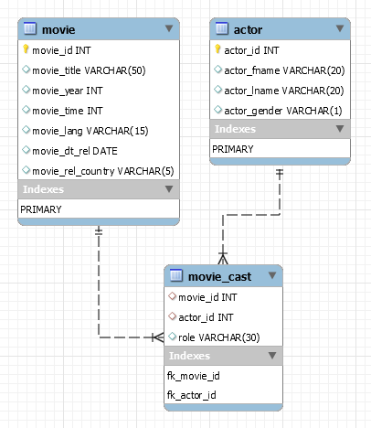
constraints – foreign key
A foreign key is a field in a table that matches another field of another table. A foreign key places constraints on data in the related tables, which enables MySQL to maintain referential integrity.
CREATE TABLE movie (
movie_id INT PRIMARY KEY,
movie_title VARCHAR(50),
movie_year INT,
movie_time INT,
movie_lang VARCHAR(15),
movie_dt_rel DATE,
movie_rel_country VARCHAR(5)
);
CREATE TABLE actor (
actor_id INT PRIMARY KEY,
actor_fname VARCHAR(20),
actor_lname VARCHAR(20),
actor_gender VARCHAR(1)
);
CREATE TABLE movie_cast (
movie_id INT,
actor_id INT,
role VARCHAR(30),
constraint fk_movie_id FOREIGN KEY(movie_id) REFERENCES movie(movie_id),
constraint fk_actor_id FOREIGN KEY(actor_id) REFERENCES actor(actor_id)
);

Slide 128
QUESTION – find foreign key columns
The following example find Foreign Key columns.
CREATE TABLE owner (
owner_id INT PRIMARY KEY,
first_name VARCHAR(50),
last_name VARCHAR(50),
email VARCHAR(255)
);
CREATE TABLE contacts (
contact_id INT PRIMARY KEY,
owner_id INT,
contact_number VARCHAR(15)
);
CREATE TABLE shop (
shop_id INT,
owner_id INT,
shop_name VARCHAR(30)
);
CREATE TABLE shop_brand (
ID INT PRIMARY KEY,
shop_id INT,
brand_id INT
);
CREATE TABLE brands (
brand_id INT PRIMARY KEY,
brand_name VARCHAR(30) UNIQUE
);

Slide 129
ALTER TABLE table_name
ADD [ CONSTRAINT constraint_name ]
FOREIGN KEY (child_col1, child_col2, . . . child_col_n)
REFERENCES parent_table (parent_col1, parent_col2, . . . parent_col_n);
Add Foreign Key Constraint using Alter

Slide 130
constraints – add foreign key using alter
You can use the ALTER TABLE statement to ADD FOREIGN KEY on existing column.
ALTER TABLE table_name
ADD [ CONSTRAINT constraint_name ]
FOREIGN KEY (child_col1, child_col2, . . . child_col_n)
REFERENCES parent_table (parent_col1, parent_col2, . . . parent_col_n);
CREATE TABLE users (
ID INT PRIMARY KEY,
userName VARCHAR(40),
password VARCHAR(255),
email VARCHAR(255) UNIQUE KEY
) ;
CREATE TABLE login (
ID INT PRIMARY KEY,
userID INT,
loginDate DATE,
loginTime TIME
) ;
ALTER TABLE login ADD FOREIGN KEY(userID) REFERENCES users(ID);
ALTER TABLE login ADD constraint fk_userID FOREIGN KEY(userID) REFERENCES users(ID);

Slide 131
ALTER TABLE table_name
DROP FOREIGN KEY constraint_name
Drop Foreign Key Constraint using Alter

Slide 132
constraints – drop foreign key
You can use the ALTER TABLE statement to DROP FOREIGN KEY.
CREATE TABLE users (
ID INT PRIMARY KEY ,
userName VARCHAR(40),
password VARCHAR(255),
email VARCHAR(255)
) ;
CREATE TABLE login (
ID INT PRIMARY KEY,
userID INT,
loginDate DATE,
loginTime TIME,
FOREIGN KEY(userID) REFERENCES users(ID)
) ;
CREATE TABLE login (
ID INT PRIMARY KEY,
userID INT,
loginDate DATE,
loginTime TIME,
constraint fk_userID FOREIGN KEY(userID) REFERENCES users(ID)
) ;
ALTER TABLE login DROP FOREIGN KEY fk_userID;
ALTER TABLE login DROP FOREIGN KEY login_ibfk_1; // login_ibfk_1 is the default constraint name.
SELECT TABLE_NAME, CONSTRAINT_NAME, CONSTRAINT_TYPE FROM information_schema.table_constraints WHERE TABLE_SCHEMA='DB2’;

Slide 133






CREATE TABLE TEST (c1 INT, c2 INT, c3 INT, check (c3 = SUM(c1)));
// ERROR
Check Constraint

Slide 134
constraints – check
CHECK condition expressions must follow some rules.
Literals, deterministic built-in functions, and operators are permitted.
Non-generated and generated columns are permitted, except columns with the AUTO_INCREMENT attribute.
Sub-queries are not permitted.
Environmental variables (such as CURRENT_USER, CURRENT_DATE, …) are not permitted.
Non-Deterministic built-in functions (such as AVG, COUNT, RAND, LAST_INSERT_ID, FIRST_VALUE, LAST_VALUE, ...) are not permitted.
Variables (system variables, user-defined variables, and stored program local variables) are not permitted.
Stored functions and user-defined functions are not permitted.
Note:
Prior to MySQL 8.0.16, CREATE TABLE permits only the following limited version of table CHECK constraint syntax, which is parsed and ignored.
Remember:
If you omit the constraint name, MySQL automatically generates a name with the following convention:
table_name_chk_n

Slide 135
constraints – check
col_name data_type CHECK(expr)
The following example creates USERS table with CHECK column.
CREATE TABLE users (
ID INT PRIMARY KEY,
userName VARCHAR(40),
password VARCHAR(255),
email VARCHAR(255),
ratings INT CHECK(ratings > 50)
) ;
CREATE TABLE users (
ID INT PRIMARY KEY,
userName VARCHAR(40),
password VARCHAR(255),
email VARCHAR(255),
ratings INT,
CHECK(ratings > 50)
) ;
CREATE TABLE users (
ID INT PRIMARY KEY,
userName VARCHAR(40),
password VARCHAR(255),
email VARCHAR(255),
ratings INT,
constraint chk_ratings CHECK(ratings > 50)
) ;
CREATE TABLE users (
ID INT PRIMARY KEY,
userName VARCHAR(40),
password VARCHAR(255),
email VARCHAR(255),
ratings INT,
constraint chk_ratings CHECK(ratings > 50),
constraint chk_email CHECK(LENGTH(email) > 12)
) ;

Slide 136
constraints – check
col_name data_type CHECK(expr)
The following example creates USERS table with CHECK column.
CREATE TABLE users (
ID INT PRIMARY KEY,
startDate DATE,
endDate DATE,
constraint chk_endDate CHECK(endDate > startDate + INTERVAL 7 day)
) ;

Slide 137
ALTER TABLE table_name
ADD [ CONSTRAINT constraint_name ]
CHECK (conidiation)
Add Check Constraint using Alter

Slide 138
constraints – add check using alter
You can use the ALTER TABLE statement to ADD CHECK KEY on existing column.
ALTER TABLE table_name
ADD CONSTRAINT [ constraint_name ]
CHECK (conidiation)
CREATE TABLE users (
ID INT PRIMARY KEY,
userName VARCHAR(40),
password VARCHAR(255),
email VARCHAR(255),
ratings INT
) ;
ALTER TABLE users ADD CHECK(ratings > 50);
ALTER TABLE users ADD constraint chk_ratings CHECK(ratings > 50);

Slide 139
ALTER TABLE table_name
DROP CHECK [ CONSTRAINT ] constraint_name
drop check constraint

Slide 140
constraints – drop check key
You can use the ALTER TABLE statement to DROP CHECK KEY.
CREATE TABLE users (
ID INT PRIMARY KEY,
userName VARCHAR(40),
password VARCHAR(255),
email VARCHAR(255),
ratings INT,
constraint chk_ratings CHECK(ratings > 50)
) ;
ALTER TABLE table_name
DROP CHECK [ CONSTRAINT ] constraint_name
ALTER TABLE users DROP CHECK chk_ratings;
ALTER TABLE users DROP constraint chk_ratings;
ALTER TABLE users DROP CHECK users_chk_1;
CREATE TABLE users (
ID INT PRIMARY KEY,
userName VARCHAR(40),
password VARCHAR(255),
email VARCHAR(255),
ratings INT,
CHECK(ratings > 50)
) ;
SELECT TABLE_NAME, CONSTRAINT_NAME, CONSTRAINT_TYPE FROM information_schema.table_constraints WHERE TABLE_SCHEMA='DB2' AND (TABLE_NAME LIKE 'U%' OR TABLE_NAME LIKE 'L%');

Slide 141
The check constraint defined on a table must refer to only columns in that table. It can not refer to columns in other tables.
CREATE TABLE test (CHECK(c3 > (c1 + c2)), c1 INT, c2 INT, c3 INT);
CREATE TABLE test (c1 INT, c2 INT, c3 INT, CHECK(c3 > (c1 + c2)));
CREATE TABLE test (CHECK(c3 > (c1 + c2)), PRIMARY KEY(c1), c1 INT, c2 INT, c3 INT);
ALTER TABLE test ADD constraint chk_id CHECK(ID > 10);
ALTER TABLE test DROP CHECK chk_id;

Slide 142
alter table
ALTER TABLE changes the structure of a table.
Note:
you can add or delete columns,
create or destroy indexes,
change the type of existing columns, or
rename columns or the table itself.

Slide 143
alter table
syntax
ALTER TABLE tbl_name
[alter_specification [, alter_specification] . . .
| ADD [COLUMN] col_name column_definition [FIRST | AFTER col_name ]
| ADD [COLUMN] (col_name column_definition, . . .)
| ADD {INDEX|KEY} [index_name] (index_col_name, . . .)
| ADD [CONSTRAINT [ symbol ]] PRIMARY KEY
| ADD [CONSTRAINT [symbol]] UNIQUE KEY
| ADD [CONSTRAINT [symbol]] FOREIGN KEY reference_definition
| CHANGE [COLUMN] old_col_name new_col_name column_definition [FIRST|AFTER col_name]
| MODIFY [COLUMN] col_name column_definition [FIRST | AFTER col_name]
| DROP [COLUMN] col_name
| DROP PRIMARY KEY
| DROP {INDEX|KEY} index_name
| DROP FOREIGN KEY fk_symbol
| RENAME [TO|AS] new_tbl_name
| ALTER [COLUMN] col_name { SET DEFAULT {literal | (expr)} | SET {VISIBLE | INVISIBLE} | DROP DEFAULT }

Slide 144
alter table
Remember:
Change Columns :- You can rename a column using a CHANGE old_col_name new_col_name column_definition clause. To do so, specify the old and new column names and the definition that the column currently has.
Modify Columns :- You can also use MODIFY to change a column's type without renaming it.
Dropping Columns :- If a table contains only one column, the column cannot be dropped. If columns are dropped from a table, the columns are also removed from any index of which they are a part. If all columns that make up an index are dropped, the index is dropped as well.
Note:
To convert a table from one storage engine to another, use an ALTER TABLE statement that indicates the new engine:
ALTER TABLE tbl_name ENGINE = InnoDB;
ALTER TABLE tbl_name ADD col1 INT, ADD col2 INT;
ALTER TABLE tbl_name DROP COLUMN col1, DROP COLUMN col2 , ADD col3 INT;

Slide 145
add column
ALTER TABLE tbl_name [alter_specification [, alter_specification] . . .]
alter_specification
ADD [COLUMN] col_name column_definition [FIRST | AFTER col_name ]
ADD [COLUMN] (col_name column_definition, . . .)

Slide 146

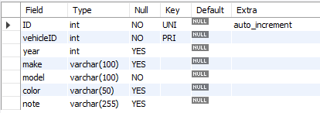
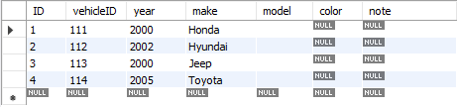
add column
CREATE TABLE vehicles (
vehicleID INT PRIMARY KEY ,
year INT,
make VARCHAR(100)
);
ALTER TABLE vehicles
ADD ID INT UNIQUE auto_increment first,
ADD model VARCHAR(100) not null,
ADD color VARCHAR(50),
ADD note VARCHAR(255);
INSERT INTO vehicles VALUES (111, 2000, 'Honda');
INSERT INTO vehicles VALUES (112, 2002, 'Hyundai');
INSERT INTO vehicles VALUES (113, 2000, 'Jeep');
INSERT INTO vehicles VALUES (114, 2005, 'Toyota');

Slide 147
modify column
ALTER TABLE tbl_name [alter_specification [, alter_specification] ...]
alter_specification
MODIFY [COLUMN] col_name column_definition [FIRST | AFTER col_name]

Slide 148
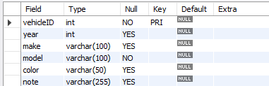
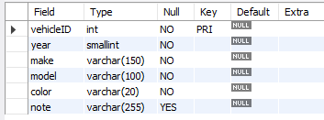
modify column
CREATE TABLE vehicles (
vehicleID INT PRIMARY KEY ,
year INT,
make VARCHAR(100),
model VARCHAR(100) not null,
color VARCHAR(50),
note VARCHAR(255)
);
ALTER TABLE vehicles
MODIFY year SMALLINT not null,
MODIFY make VARCHAR(150) not null,
MODIFY color VARCHAR(20) not null;
INSERT INTO vehicles VALUES (111, 2000, 'Honda', 'A1', 'silver', ' Honda was the first Japanese automobile manufacturer to release a dedicated luxury brand, Acura, in 1986.');
INSERT INTO vehicles VALUES (112, 2002, 'Hyundai', 'AC1', 'white', ' Hyundai operates the world's largest integrated automobile manufacturing facility in Ulsan, South Korea which has an annual production capacity of 1.6 million units.');
INSERT INTO vehicles VALUES (113, 2000, 'Jeep', 'D2', 'black', ' Fiat Chrysler Automobiles has owned Jeep since 2014. Previous owners include the Kaiser Jeep Corporation and American Motors Corporation. Most Jeeps are American-made, except for a select few models. The Toledo Assembly Complex in Ohio manufactures the Jeep Wrangler.');

Slide 149
change column
ALTER TABLE tbl_name [alter_specification [, alter_specification] ...]
alter_specification
CHANGE [COLUMN] old_col_name new_col_name column_definition [ FIRST | AFTER col_name ]

Slide 150
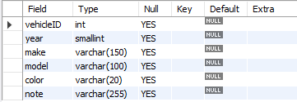
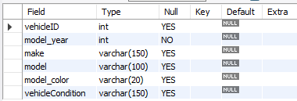
change column
CREATE TABLE vehicles (
vehicleID INT,
year SMALLINT,
make VARCHAR(150),
model VARCHAR(100),
color VARCHAR(20),
note VARCHAR(255)
);
ALTER TABLE vehicles
CHANGE year model_year INT,
CHANGE color model_color VARCHAR(20),
CHANGE note vehicleCondition VARCHAR(150);

Slide 151
change column
CREATE TABLE users (
ID INT PRIMARY KEY,
userName VARCHAR(40),
password VARCHAR(25),
email VARCHAR(255)
) ;
CREATE TABLE login (
ID INT PRIMARY KEY,
userID INT,
loginDate DATE,
loginTime TIME,
constraint fk_userID FOREIGN KEY(userID) REFERENCES users(ID)
) ;
INSERT INTO users VALUES (1, 'rajan', 'ranaj123', 'rajan447.gmail.com');
INSERT INTO users VALUES (2, 'raj', 'raj', 'raj.gmail.com');
INSERT INTO login VALUES (1, 1, curdate(), curtime());
INSERT INTO login VALUES (2, 1, curdate(), curtime());
INSERT INTO login VALUES (3, 2, curdate(), curtime());
INSERT INTO login VALUES (4, NULL, curdate(), curtime());
ALTER TABLE users CHANGE ID userID INT;
ALTER TABLE login CHANGE userID UID INT;
INSERT INTO login VALUES (5, NULL, curdate(), curtime());

Slide 152
drop column
ALTER TABLE tbl_name [alter_specification [, alter_specification] ...]
alter_specification
DROP [COLUMN] col_name

Slide 153
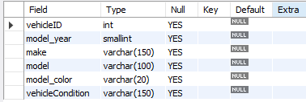

drop column
CREATE TABLE vehicles (
vehicleID INT,
model_year SMALLINT,
make VARCHAR(150),
model VARCHAR(100),
model_color VARCHAR(20),
vehicleCondition VARCHAR(150)
);
ALTER TABLE vehicles
CHANGE model_year year INT not null,
DROP model,
DROP model_color,
DROP vehicleCondition;

Slide 154
alter table
Sample table
Rename columns
CREATE TABLE vehicles (
vehicleID INT PRIMARY KEY ,
year INT,
make VARCHAR(100)
);
ALTER TABLE vehicles
CHANGE year model_year SMALLINT NOT NULL,
CHANGE color model_color VARCHAR(20),
CHANGE note vehicleCondition VARCHAR(150);
Add new columns to a table
DROP columns
ALTER TABLE vehicles
ADD model VARCHAR(100) NOT NULL,
ADD color VARCHAR(50),
ADD note VARCHAR(255);
ALTER TABLE vehicles
CHANGE model_year year INT NOT NULL,
DROP model,
DROP model_color,
DROP vehicleCondition;
Modify columns
ALTER TABLE vehicles
MODIFY year SMALLINT NOT NULL,
MODIFY color VARCHAR(20) NOT NULL,
MODIFY make VARCHAR(150) NOT NULL;

Slide 155
drop table
Remember:
DROP and TRUNCATE are DDL commands, whereas DELETE is a DML command.
DELETE operations can be rolled back (undone), while DROP and TRUNCATE operations cannot be rolled back (Auto COMMIT).
Dropping a TABLE also drops any TRIGGERS for the table.
Dropping a TABLE also drops any INDEX for the table.
Dropping a TABLE will not drops any VIEW for the table.
If you try to drop a PARENT/MASTER TABLE, it will not get dropped.

Slide 156
drop table
DROP [TEMPORARY] TABLE [IF EXISTS] tbl_name [, tbl_name] ...
Note:
All table data and the table definition are removed.
DROP login;
DROP TABLE users;
DROP TABLE login, users;

Slide 157
Do not use the * operator in your SELECT statements. Instead, use column names. Reason is that in MySQL Server scans for all column names and replaces the * with all the column names of the table(s) in the SELECT statement. Providing column names avoids this search-and-replace, and enhances performance.
SELECT statement…
SELECT what_to_select
FROM which_table
WHERE conditions_to_satisfy;

Slide 158
SELECT CLAUSE
The SELECT statement retrieves or extracts data from tables in the database.
You can use one or more tables separated by comma to extract data.
You can fetch one or more fields/columns in a single SELECT command.
You can specify star (*) in place of fields. In this case, SELECT will return all the fields.
SELECT can also be used to retrieve rows computed without reference to any table e.g. SELECT 1 + 2;

Slide 159
Capabilities of SELECT Statement
SELECTION
PROJECTION
JOINING

Slide 160
Capabilities of SELECT Statement
SELECTION
Selection capability in SQL is to choose the rows in a table that you want to return by a query.
R
EMPNO | ENAME | JOB | HIREDATE | DEPTNO
1 | Saleel | Manager | 1995-01-01 | 10
2 | Janhavi | Sales | 1994-12-20 | 20
3 | Snehal | Manager | 1997-05-21 | 10
4 | Rahul | Account | 1997-07-30 | 10
5 | Ketan | Sales | 1994-01-01 | 30

Slide 161
Capabilities of SELECT Statement
PROJECTION
Projection capability in SQL to choose the columns in a table that you want to return by your query.
R
EMPNO | ENAME | JOB | HIREDATE | DEPTNO
1 | Saleel | Manager | 1995-01-01 | 10
2 | Janhavi | Sales | 1994-12-20 | 20
3 | Snehal | Manager | 1997-05-21 | 10
4 | Rahul | Account | 1997-07-30 | 10
5 | Ketan | Sales | 1994-01-01 | 30

Slide 162
Capabilities of SELECT Statement
JOINING
Join capability in SQL to bring together data that is stored in different tables by creating a link between them.
R
S
EMPNO | ENAME | JOB | HIREDATE | DEPTNO
1 | Saleel | Manager | 1995-01-01 | 20
2 | Janhavi | Sales | 1994-12-20 | 10
3 | Snehal | Manager | 1997-05-21 | 10
4 | Rahul | Account | 1997-07-30 | 20
5 | Ketan | Sales | 1994-01-01 | 30
DEPTNO | DNAME | LOC
10 | HRD | PUNE
20 | SALES | BARODA
40 | PURCHASE | SURAT

Slide 163
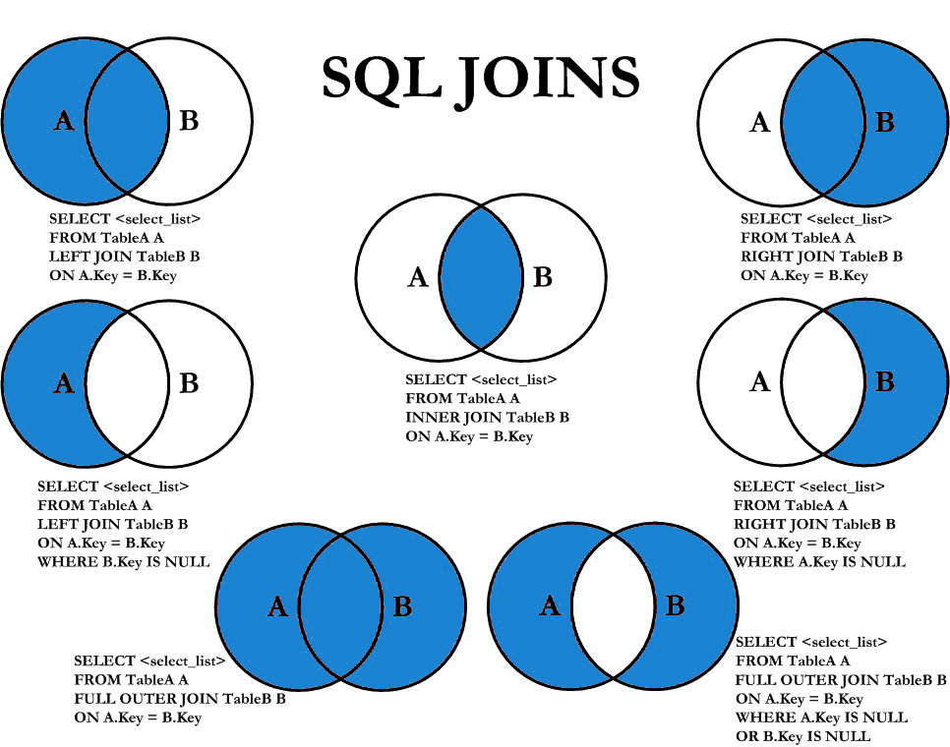

Slide 164
select statement
SELECTION Process
SELECT * FROM <table_references>
selection-list | field-list | column-list
PROJECTION Process
SELECT column-list FROM <table_references>
selection-list | field-list | column-list

Slide 165
SELECT 'HELLO' ' WORLD';
SELECT 'HELLO' AS 'WORLD';
SELECT ename `EmployeeName` FROM emp;
SELECT ename AS `EmployeeName` FROM emp;
column - alias
A programmer can use an alias to temporarily assign another name to a column or table for the duration of a SELECT query.
In the selection-list, a quoted column alias can be specified using identifier ( ` ) or string quote ( ' or " ) characters.
Note:
Assigning an alias_name does not actually rename the column or table.

Slide 166
select statement - alias
SELECT A₁ [ [AS] alias_name], A₂ [ [AS] alias_name], . . ., A_{N} FROM r [ [AS] alias_name]
Remember:
A select_expr can be given an alias using AS alias_name. The alias is used as the expression's column name and can be used in GROUP BY, HAVING, or ORDER BY clauses.
The AS keyword is optional when aliasing a select_expr with an identifier.
Standard SQL disallows references to column aliases in a WHERE clause.
A table reference can be aliased using tbl_name alias_name or tbl_name AS alias_name
If the column alias contains spaces, put it in quotes.
Alias name is max 256 characters.
SELECT empno AS EmployeeID, ename EmployeeName FROM emp;
SELECT ID AS 'Employee ID', ename "Employee Name" FROM emp;
SELECT * FROM emp employee;

Slide 167
comparison functions and operator
Comparison operations result in a value of 1 (TRUE), 0 (FALSE), or NULL.
assignment _operator
= (assignment), :=
The value on the right hand side may be a literal value, another variable storing a value, or any legal expression that yields a scalar value, including the result of a query (provided that this value is a scalar value). You can perform multiple assignments in the same SET statement. You can perform multiple assignments in the same statement.
Unlike =, the := operator is never interpreted as a comparison operator. This means you can use := in any valid SQL statement (not just in SET statements) to assign a value to a variable.

Slide 168
comparison functions and operator
arithmetic_operators:
* | / | DIV | % |MOD | - | +
comparison_operator:
= | <=> | >= | > | <= | < | <> | !=
boolean_ predicate:
IS [NOT] NULL
| expr <=> null
predicate:
expr [NOT] LIKE expr [ESCAPE char]
| expr [NOT] IN (expr1, expr2, . . . )
| expr [NOT] IN (subquery)
| expr [NOT] BETWEEN expr1 AND expr2
logical_operators
{ AND | && } | { OR | || }
assignment _operator
= (assignment), :=
operand meaning: the quantity on which an operation is to be done.
e.g.
operand1 * operand2
operand1 = operand2
operand IS [NOT] NULL
operand [NOT] LIKE 'pattern'
expr AND expr
Operand := 1001
SELECT 23 DIV 6 ; #3
SELECT 23 / 6 ; #3 .8333
Note:
AND has higher precedence than OR.

Slide 169
WHERE col * 4 < 16
WHERE col < 16 / 4
column - expressions
"Strings are automatically converted to numbers and numbers to strings as necessary." This means that in order to compare a string to a number, it tries to parse a number from the start of the string. In this case there is no number there, so it converts to 0, and 0 = 0 is true.

Slide 170
select statement - expressions
Column EXPRESSIONS
SELECT A₁, A₂, A₃, A₄, expressions, . . . FROM r
SELECT 1001 + 1;
SELECT 1001 + '1';
SELECT '1' + '1' ;
SELECT '1' + 'a1';
SELECT '1' + '1a';
SELECT 'a1' + 1;
SELECT '1a' + 1;
SELECT 1 + -1;
SELECT 1 + -2;
SELECT -1 + -1;
SELECT -1 - 1;
SELECT -1 - -1;
SELECT 123 * 1;
SELECT -123 * 1;
SELECT 123 * -1 ;
SELECT -123 * -1;
SELECT 2 * 0;
SELECT 2435 / 1;
SELECT 2 / 0;
SELECT '2435Saleel' / 1;
SELECT sal, sal + 1000 AS 'New Salary' FROM emp;
SELECT sal, comm, sal + comm FROM emp;
SELECT sal, comm, sal + IFNULL(comm, 0) FROM emp;
SELECT ename, ename = ename FROM emp;
SELECT ename, ename = 'smith' FROM emp;
SELECT c1, c1 / 1 R1 FROM numberString;

Slide 171
identifiers
Certain objects within MySQL, including database, table, index, column, alias, view, stored procedure, stored functions, triggers, partition, tablespace, and other object names are known as identifiers.

Slide 172
identifiers
The maximum length for each type of identifiers like (Database, Table, Column, Index, Constraint, View, Stored Program, User-Defined Variable, Tablespace) is 64 characters, whereas for Alias is 256 characters.
You can refer to a table within the default database as
tbl_name
db_name.tbl_name.
You can refer to a column as
col_name
tbl_name.col_name
db_name.tbl_name.col_name.
Note:
You need not specify a tbl_name or db_name.tbl_name prefix for a column reference unless the reference would be ambiguous.
The identifier quote character is the backtick (`)

Slide 173
+ or - operator
Date arithmetic also can be performed using INTERVAL together with the + or - operator
date + INTERVAL expr unit + INTERVAL expr unit + INTERVAL expr unit + . . .
date - INTERVAL expr unit - INTERVAL expr unit - INTERVAL expr unit - . . .
SELECT NOW(), NOW() + INTERVAL 1 DAY;
SELECT NOW(), NOW() + INTERVAL '1-3' YEAR_MONTH;
unit Value | expr | unit Value | expr
SECOND | SECONDS | DAY_HOUR | 'DAYS HOURS' e.g. '1 1'
MINUTE | MINUTES | DAY_MINUTE | 'DAYS HOURS:MINUTES' e.g. '1 3:34'
HOUR | HOURS | DAY_SECOND | 'DAYS HOURS:MINUTES:SECONDS'
DAY | DAYS | HOUR_MINUTE | 'HOURS:MINUTES' e.g. '3:34'
WEEK | WEEKS | HOUR_SECOND | 'HOURS:MINUTES:SECONDS'
MONTH | MONTHS | MINUTE_SECOND | 'MINUTES:SECONDS' e.g. '27:34'
QUARTER | QUARTERS | YEAR_MONTH | 'YEARS-MONTHS' e.g. '1-3'
YEAR | YEARS

Slide 174
adddate()
ADDDATE() is a synonym for DATE_ADD()
ADDDATE(date, INTERVAL expr unit) / DATE_ADD (date, INTERVAL expr unit)
SELECT NOW(), ADDDATE(NOW(), INTERVAL 1 DAY);
SELECT NOW(), DATE_ADD(NOW(), INTERVAL 1 DAY);
unit Value | ExpectedexprFormat
SECOND | SECONDS
MINUTE | MINUTES
HOUR | HOURS
DAY | DAYS
WEEK | WEEKS
MONTH | MONTHS
QUARTER | QUARTERS
YEAR | YEARS

Slide 175
subdate()
SUBDATE() is a synonym for DATE_SUB()
SUBDATE(date, INTERVAL expr unit) / DATE_SUB (date, INTERVAL expr unit)
SELECT NOW(), SUBDATE(NOW(), INTERVAL 1 DAY);
SELECT NOW(), DATE_SUB(NOW(), INTERVAL 1 DAY);
unit Value | ExpectedexprFormat
SECOND | SECONDS
MINUTE | MINUTES
HOUR | HOURS
DAY | DAYS
WEEK | WEEKS
MONTH | MONTHS
QUARTER | QUARTERS
YEAR | YEARS

Slide 176
addtime()
ADDTIME() adds expr2 to expr1 and returns the result. expr1 is a time or datetime expression, and expr2 is a time expression.
ADDTIME(expr1, expr2)
SELECT NOW(), ADDTIME(NOW(), '1:1:1') # 'HH:MM:SS'
SELECT NOW(), ADDTIME(NOW(), '2 2:10:5') # 'DAY HH:MM:SS'
Adding 15 seconds.
SELECT NOW(), ADDTIME(NOW(), "15") AS Updated_time;
Adding 10 minutes.
SELECT NOW(), ADDTIME(NOW(), "00:10:00") AS Updated_time;
Adding 2 hours.
SELECT NOW(), ADDTIME(NOW(), "2:00:00") AS Updated_time;
Adding 10 hours 30 minute 25 second and 100000 Microseconds.
SELECT NOW(), ADDTIME(NOW(), "10:30:25.100000") AS Updated_time;
Adding 1 day 2 hours 30 minute 25 second.
SELECT NOW(), ADDTIME(NOW(), "1 2:30:25") AS Updated_time;

Slide 177
subtime()
=
SUBTIME() returns expr1 − expr2 expressed as a value in the same format as expr1. expr1 is a time or datetime expression, and expr2 is a time expression.
SUBTIME(expr1, expr2)
SELECT NOW(), SUBTIME(NOW(), '1:1:1'); # 'HH:MM:SS'
SELECT NOW(), SUBTIME(NOW(), '2 1:1:1'); # 'DAY HH:MM:SS'
Subtract 15 seconds.
SELECT NOW(), SUBTIME(NOW(), "15") AS Updated_time;
Subtract 10 minutes.
SELECT NOW(), SUBTIME(NOW(), "00:10:00") AS Updated_time;
Subtract 2 hours.
SELECT NOW(), SUBTIME(NOW(), "2:00:00") AS Updated_time;
Subtract 10 hours 30 minute 25 second and 100000 Microseconds.
SELECT NOW(), SUBTIME(NOW(), "10:30:25.100000") AS Updated_time;
Subtract 1 day 2 hours 30 minute 25 second.
SELECT NOW(), SUBTIME(NOW(), "1 2:30:25") AS Updated_time;

Slide 178
extract
The EXTRACT() function is used to return a single part of a date/time, such as year, month, day, hour, minute, etc.
EXTRACT(unit FROM date)
Unit Value
MICROSECOND | SECOND | MINUTE | HOUR | DAY
WEEK | MONTH | QUARTER | YEAR
MINUTE_SECOND | HOUR_SECOND | DAY_SECOND | DAY_HOUR
HOUR_MINUTE | DAY_MINUTE | YEAR_MONTH
SELECT EXTRACT(MONTH FROM NOW());
SELECT EXTRACT(YEAR_MONTH FROM NOW()) ;
Note:
There must no space between extract function and ().
e.g.
SELECT EXTRACT (MONTH FROM NOW()); # error

Slide 179
datetime functions
Syntax | Result
DAY(date) | DAY() is a synonym for DAYOFMONTH().
DAYNAME(date) | Returns the name of the weekday for date.
DAYOFMONTH(date) | Returns the day of the month for date, in the range 1 to 31
DAYOFWEEK(date) | Returns the weekday index for date (1 = Sunday, 2 = Monday, …, 7 = Saturday).
DAYOFYEAR(date) | Returns the day of the year for date, in the range 1 to 366
LAST_DAY(date) | Takes a date or datetime value and returns the corresponding value for the last day of the month. Returns NULL if the argument is invalid.
MONTH(date) | Returns the month for date, in the range 1 to 12 for January to December
MONTHNAME(date) | Returns the full name of the month for date.
YEAR(date) | Returns the year in 4 digit
SELECT DAYOFWEEK(NOW()), WEEKDAY(NOW());
SELECT DAYOFWEEK(ADDDATE(NOW(), INTERVAL 1 DAY)), WEEKDAY(ADDDATE(NOW(), INTERVAL 1 DAY));

Slide 180
datetime functions
Syntax | Result
WEEKDAY(date) | Returns the weekday index for date (0 = Monday, 1 = Tuesday, … 6 = Sunday).
WEEKOFYEAR(date) | Returns the calendar week of the date as a number in the range from 1 to 53.
QUARTER(date) | Returns the quarter of the year for date, in the range 1 to 4.
HOUR(time) | Returns the hour for time. The range of the return value is 0 to 23 for time-of-day values.
MINUTE(time) | Returns the minute for time, in the range 0 to 59.
SECOND(time) | Returns the second for time, in the range 0 to 59.
DATEDIFF(expr1, expr2) | Returns the number of days between two dates or datetimes.
STR_TO_DATE(str, format) | Convert a string to a date.
SELECT NOW(), NOW() + INTERVAL 1 DAY, WEEKDAY(NOW() + INTERVAL 1 DAY);
SELECT * FROM emp WHERE DAY(hiredate) = 17;
SELECT YEAR(hiredate), ( YEAR(hiredate) % 4 = 0 AND YEAR(hiredate) % 100 != 0 ) OR YEAR(hiredate) % 400 = 0 R1 FROM emp ;
SELECT STR_TO_DATE('24/05/2022', '%d/%m/%Y');

Slide 181
datetime formats

Slide 182
datetime formats
Formats | Description
%a | Abbreviated weekday name (Sun-Sat)
%b | Abbreviated month name (Jan-Dec)
%c | Month, numeric (1-12)
%D | Day of month with English suffix (0th, 1st, 2nd, 3rd)
%d | Day of month, numeric (01-31)
%e | Day of month, numeric (1-31)
%f | Microseconds (000000-999999)
%H | Hour (00-23)
%h | Hour (01-12)
SELECT DATE_FORMAT(NOW(), '%a');

Slide 183
datetime formats
Formats | Description
%I | Hour (01-12)
%i | Minutes, numeric (00-59)
%j | Day of year (001-366)
%k | Hour (0-23)
%l | Hour (1-12)
%M | Month name (January-December)
%m | Month, numeric (01-12)
%p | AM or PM
%r | Time, 12-hour (hh:mm:ss followed by AM or PM)
%S | Seconds (00-59)
%s | Seconds (00-59)
SELECT DATE_FORMAT(NOW(), '%j');

Slide 184
datetime formats
Formats | Description
%T | Time, 24-hour (hh:mm:ss)
%U | Week (00-53) where Sunday is the first day of week
%u | Week (00-53) where Monday is the first day of week
%V | Week (01-53) where Sunday is the first day of week, used with %X
%v | Week (01-53) where Monday is the first day of week, used with %x
%W | Weekday name (Sunday-Saturday)
%w | Day of the week (0=Sunday, 6=Saturday)
%X | Year for the week where Sunday is the first day of week, four digits, used with %V
%x | Year for the week where Monday is the first day of week, four digits, used with %v
%Y | Year, numeric, four digits
%y | Year, numeric, two digits
SELECT DATE_FORMAT(NOW(), '%Y');

Slide 185
string functions

Slide 186
string functions
Syntax | Result
ASCII(str) | Returns the numeric value of the leftmost character of the string str. Returns 0 if str is the empty string. Returns NULL if str is NULL. e.g. SELECT ASCII(ename) FROM emp;
CHAR(N, , . . .) | CHAR() interprets each argument N as an integer and returns a string consisting of the characters given by the code values of those integers. NULL values are skipped. e.g. SELECT CHAR(65, 66, 67); / SELECT CAST(CHAR(65 66, 67) AS CHAR);
CONCAT(str1, str2, . . .) | Returns the string that results from concatenating the arguments. CONCAT() returns NULL if any argument is NULL. e.g. SELECT CONCAT('Mr. ' , ename) FROM emp; SELECT CONCAT('My', NULL, 'SQL’); #op will be NULL
ELT(N, str1, str2, str3, . . .) | ELT() returns the Nth element of the list of strings: str1 if N = 1, str2 if N = 2, and so on. Returns NULL if N is less than 1 or greater than the number of arguments. e.g. SELECT ELT(1, 'Bank', 'Of', 'India', 'Kothrud', 'Pune'); SELECT ELT(1, ename, job, sal) FROM emp; SELECT hiredate, ELT(MONTH(hiredate),'Winter', 'Winter', 'Spring', 'Spring', 'Spring', 'Summer', 'Summer', 'Summer', 'Autumn', 'Autumn', 'Autumn', 'Winter') R1 FROM emp;

Slide 187
string functions
Syntax | Result
STRCMP(expr1, expr2) | STRCMP() returns 0 if the strings are the same, -1 if the first argument is smaller than the second according to the current sort order, and 1 otherwise.
LCASE(str) | Returns lower case string. LCASE() is a synonym for LOWER().
UCASE(str) | Returns upper case string. UCASE() is a synonym for UPPER().
LENGTH(str) | Returns the length of the string.
LPAD(str, len, padstr) | Returns the string str, left-padded with the string padstr to a length of len characters.
RPAD(str, len, padstr) | Returns the string str, right-padded with the string padstr to a length of len characters.
REPEAT(str, count) | Returns a string consisting of the string str repeated count times. If count is less than 1, returns an empty string. Returns NULL if str or count are NULL.
SELECT UCASE(ename) FROM emp;
SELECT sal, LPAD(sal, 20, '*') FROM emp;
SELECT sal, REPEAT('$', sal/100) FROM emp;
SELECT emailid, REPEAT('*', LENGTH(emailid)) FROM emp;
SELECT pwd, REPEAT('*', LENGTH(pwd)) password FROM emp;

Slide 188
string functions
Syntax | Result
LEFT(str, len) | Returns the leftmost len characters from the string str, or NULL if any argument is NULL.
RIGHT(str, len) | Returns the rightmost len characters from the string str, or NULL if any argument is NULL.
LTRIM(str) | Returns the string str with leading space characters removed.
RTRIM(str) | Returns the string str with trailing space characters removed.
TRIM(str) | Returns the string str with leading and trailing space characters removed.
BINARY value | Convert a value to a binary string.
SELECT ename, BINARY ename FROM emp;
SELECT * FROM emp1 WHERE ename = BINARY "sherlock";
SELECT * FROM emp1 WHERE ename = BINARY "Sherlock";
SELECT * FROM emp1 WHERE ename = BINARY UPPER(ename);
SELECT * FROM emp1 WHERE ename = BINARY LOWER(ename);
SELECT CONCAT(UCASE(LEFT(ename, 1)), LCASE(SUBSTRING(ename, 2))) "Title Case" FROM;
SELECT * FROM emp1 WHERE ename = BINARY CONCAT(UCASE(LEFT(ename, 1)), LCASE(SUBSTRING(ename, 2)));

Slide 189
string functions
Syntax | Result
INSTR(str, substr) | Returns the position of the first occurrence of substring substr in string str.
REPLACE(str, from_str, to_str) | Returns the string str with all occurrences of the string from_str replaced by the string to_str. REPLACE() performs a case-sensitive match when searching for from_str. e.g. SELECT REPLACE('Hello', 'l', 'x');
REVERSE(str) | Returns the string str with the order of the characters reversed.
SUBSTR(str, pos, len) | SUBSTR() is a synonym for SUBSTRING(). e.g. SELECT SUBSTR ('This is the test by IWAY', 6); SELECT SUBSTR ('This is the test by IWAY', -4, 4);
MID(str, pos, len) | MID function is a synonym for SUBSTRING.
SELECT ename, job, IF(ISNULL(phone), '**********', RPAD(LEFT(phone, 4), 10, '*')) FROM emp;
SELECT `user name`, IF(LENGTH(SUBSTR(`user name`, INSTR(`user name`," "))) = 0,"Weak User", `user name`) R1 FROM emp;
SELECT LENGTH('saleel') - LENGTH(REPLACE('saleel', 'e', "" ));
SELECT empno, datePresent, LENGTH(datePresent) - LENGTH(REPLACE(datePresent, ",", "")) "Days Present" FROM emp_attendance;
SELECT c1, c1 / 1, SUBSTR(c1, LENGTH(c1 / 1) + 1) FROM numberString;

Slide 190
mathematical functions

Slide 191
mathematical functions
Syntax | Result
ABS(x) | Returns the absolute value of X.
CEIL(x) | CEIL() is a synonym for CEILING().
CEILING(x) | Returns CEIL value.
FLOOR(x) | Returns FLOOR value.
MOD(n, m), n % m, n MOD m | Returns the remainder of N divided by M. MOD(N,0) returns NULL.
POWER(x, y) | This is a synonym for POW().
RAND() | Returns a random floating-point value
ROUND(x) ROUND(x, d) | Rounds the argument X to D decimal places. The rounding algorithm depends on the data type of X. D defaults to 0 if not specified. D can be negative to cause D digits left of the decimal point of the value X to become zero.
TRUNCATE(x, d) | Returns the number X, truncated to D decimal places. If D is 0, the result has no decimal point or fractional part. D can be negative to cause D digits left of the decimal point of the value X to become zero.

Slide 192
mathematical functions
e.g.
SELECT CEIL(1.23);
SELECT CEIL(-1.23);
SELECT FLOOR(1.23);
SELECT FLOOR(-1.23);
SELECT ROUND(-1.23);
SELECT ROUND(-1.58);
SELECT ROUND(RAND() * 100);
SELECT FLOOR(RAND() * 899999 + 100000) OTP;
SELECT weight, TRUNCATE(weight, 0) AS kg, MID(weight, INSTR(weight, ".") + 1) AS gms FROM mass_table;

Slide 193
Note:
TABLE always displays all columns of the table.
TABLE does not support any WHERE clause.
TABLE can be used with temporary tables.
table statement…
TABLE is a DML statement introduced in MySQL 8.0.19 which returns rows and columns of the named table.

Slide 194
table statement
The TABLE statement in some ways acts like SELECT. You can order and limit the number of rows produced by TABLE using ORDER BY and LIMIT clauses, respectively.
TABLE tbl_name [ORDER BY col_name] [LIMIT number [OFFSET number]]
TABLE emp;
TABLE emp ORDER BY 2;
TABLE emp ORDER BY 2 LIMIT 1, 2;
TABLE t1 UNION TABLE t2;

Slide 195

select statement… syntax
SELECT is used to retrieve rows selected from one or more tables (using JOINS), and can include UNION statements and SUBQUERIES.

Slide 196
syntax
select statement
modifiers
SELECT [ALL / DISTINCT / DISTINCTROW] identifier.* / identifier.A₁ [ [as] alias_name], identifier.A₂ [ [as] alias_name], identifier.A₃ [ [as] alias_name], expression1 [ [as] alias_name], expression2 [ [as] alias_name] . . .
[ FROM <identifier.r₁> [as] alias_name], <identifier.r₂> [as] alias_name], . . . ]
[ WHERE < where_condition1 > { and | or } < where_condition2 > . . . ]
[ GROUP BY < { col_name | expr | position }, . . . [ WITH ROLLUP ] > ]
[ HAVING < having_condition1 > { and | or } < having_condition2 > . . . ]
[ ORDER BY < { col_name | expr | position } [ ASC | DESC ], . . . > ]
[ LIMIT < { [offset,] row_count | row_count OFFSET offset } > ]
[ FOR { UPDATE } ]
[ { INTO OUTFILE 'file_name' | INTO DUMPFILE 'file_name' | INTO var_name [, var_name], . . . } ]
Remember:
ALL (modifier is default) specifies that all matching rows should be returned, including duplicates.
DISTINCT (modifier) specifies removal of duplicate rows from the result set.
DISTINCTROW (modifier) is a synonym for DISTINCT.
It is an error to specify both modifiers.

Slide 197
sequence of clauses
WHERE
GROUP BY
HAVING
ORDER BY
LIMIT
select statement… execution
FROM
WHERE
GROUP BY
HAVING
SELECT
DISTINCT
LIMIT
ORDER BY

Slide 198
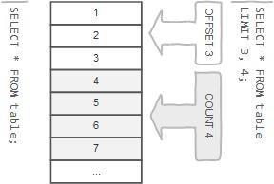
row limiting clause
LIMIT is applied after HAVING
Remember:
LIMIT enables you to pull a section of rows from the middle of a result set. Specify two values: The number of rows to skip at the beginning of the result set, and the number of rows to return.
Note:
Limit value are not to be given within ( . . . )
Limit takes one or two numeric arguments, which must both be non-negative integer value.

Slide 199
select - limit
SELECT A₁, A₂, A₃, . . . FROM r
[ LIMIT { [offset,] row_count | row_count OFFSET offset } ]
You can specify an offset using OFFSET from where SELECT will start returning records. By default offset is zero.
SELECT * FROM emp LIMIT 5 OFFSET 1;
READ
FROM
SELECT
LIMIT
1, 5 | 5 offset 1
output
emp
identifier.*
SELECT * FROM student LIMIT 5;
SELECT * FROM student LIMIT 1, 5;
SELECT * FROM student LIMIT 5 offset 1;
SELECT RAND(), student.* FROM student ORDER BY 1 LIMIT 1;
SELECT student.* FROM student ORDER BY RAND() LIMIT 1;

Slide 200
Nulls by default occur at the top, but you can use IsNull to assign default values, that will put it in the position you require. . The ISNULL() function tests whether an expression is NULL. If expression is a NULL value, the ISNULL() function returns 1. Otherwise, it returns 0.
SELECT id AS 'a' FROM tbl_name ORDER BY `a`;
SELECT id AS 'a' FROM tbl_name ORDER BY 'a';
order by clause
To sort a result, use an ORDER BY clause.
Remember:
The default sort order is ascending ASC, with smallest values first. To sort in descending (reverse) order, add the DESC keyword to the name of the column you are sorting by.
You can sort on multiple columns, and you can sort different columns in different directions.
If the ASC or DESC modifier is not provided in the ORDER BY clause, the results will be sorted by expression in ASC (ascending) order. This is equivalent to ORDER BY expression ASC.

Slide 201
select - order by
When doing an ORDER BY, NULL values are placed first if you do ORDER BY ... ASC and last if you do ORDER BY ... DESC.
SELECT A₁, A₂, A₃, A_{n} FROM r
[ORDER BY {A₁, A₂, A₃, . . . | expr | position} [ASC | DESC] , . . . ]
"Ordered by attributes A₁, A₂, A₃ …"
Tuples are sorted by specified attributes
Results are sorted by A₁ first
Within each value of A₁, results are sorted by A₂ then within each value of A₂, results are sorted by A₃
SELECT * FROM r ORDER BY key_part1, key_part2; // optimizer does not use the index.
SELECT key_part1, key_part2 FROM r ORDER BY key_part1, key_part2; // optimizer uses the index.

Slide 202
select - order by
The ORDER BY clause is used to sort the records in your result set.
SELECT A₁, A₂, A₃, A_{n} FROM r
[ORDER BY {A₁, A₂, A₃, . . . | expr | position} [ASC | DESC] , . . . ]
READ
FROM
SELECT
ORDER BY
identifier.job ASC, identifier.ename DESC
output
identifier.*
emp
READ
FROM
SELECT
ORDER BY
identifier.job DESC, identifier.ename ASC
output
identifier.ename, identifier.job
emp

Slide 203
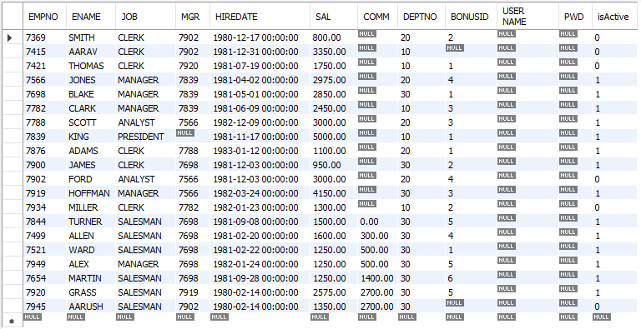
select - order by
When doing an ORDER BY, NULL values are presented first if you do ORDER BY ... ASC
SELECT * FROM emp ORDER BY comm ASC;

Slide 204
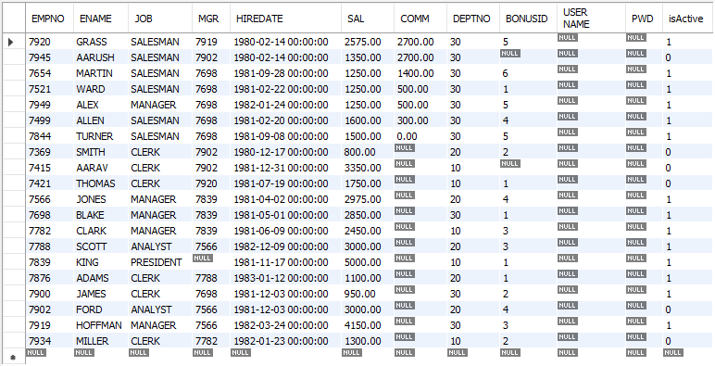
select - order by
When doing an ORDER BY, NULL values are presented last if you do ORDER BY ... DESC.
SELECT * FROM emp ORDER BY comm DESC;

Slide 205
select - order by
SELECT A₁, A₂, A₃, A_{n} FROM r
[ORDER BY {A₁, A₂, A₃, . . . | expr | position} [ASC | DESC] , . . . ]
SELECT * FROM emp ORDER BY comm;
SELECT * FROM emp ORDER BY comm IS NULL ;
SELECT * FROM emp ORDER BY comm IS NOT NULL ;
SELECT * FROM emp ORDER BY 1 + 1;
SELECT * FROM emp ORDER BY True;
SELECT ename, LENGTH(ename) FROM emp ORDER BY LENGTH(ename), ename DESC ;
SELECT * FROM emp ORDER BY IF(job = 'manager', 3, IF(job = 'salesman', 2, NULL)) ;
SELECT * FROM emp ORDER BY FIELD(job, 'manager', 'salesman') ;
SELECT * FROM emp ORDER BY ISNULL(comm), comm ;
SELECT ename `e` FROM emp ORDER BY `e` ;
SELECT ename `e` FROM emp ORDER BY e ;
SELECT ename 'e' FROM emp ORDER BY 'e' ;
SELECT * FROM emp ORDER BY CASE WHEN ename='sharmin' THEN 0 ELSE 1 END, ename;

Slide 206
Remember:
In WHERE clause operations can be performed using…
CONSTANTS
TABLE columns
FUNCTION calls (PRE-DEFINED / UDF)
In SQL, a logical expression is often called a predicate.
where clause
The WHERE Clause is used when you want to retrieve specific information from a table excluding other irrelevant data.
Note:
Expressions in WHERE clause can use.
Arithmetic operators
Comparison operators
Logical operators
Note:
All comparisons return FALSE when either argument is NULL, so no rows are ever selected.

Slide 207
select - where
We can use a conditional clause called WHERE clause to filter out results. Using WHERE clause, we can specify a selection criteria to select required records from a table.
SELECT A₁, A₂, A₃, . . . FROM r₁, r₂, r₃, . . . [ WHERE P ]
r_{i} are the relations (tables)
A_{i} are attributes (columns)
P is the selection predicate
Remember:
A predicate is a condition expression that evaluates to a boolean value, either true or false.
Predicates can be used as follows: In a SELECT statement's WHERE clause or HAVING clause to determine which rows are relevant to a particular query.
A value of zero is considered false. Nonzero values are considered true.
SELECT true, false, TRUE, FALSE, True, False;

Slide 208
select - where
SELECT A₁, A₂, A₃, . . . FROM r₁, r₂, r₃, . . . [ WHERE P ]
comparison_operator:
= | <=> | >= | > | <= | < | <> | !=
logical_operators
{ AND | && } | { OR | || }
What will be the result of the query below?
SELECT 1 = 1;
SELECT True = 1;
SELECT True = 2;
SELECT True = True;
SELECT 0 = 0;
SELECT False = False;
SELECT False = 1;
SELECT 'a' = 1;
SELECT 'a' = 0;
SELECT * FROM emp WHERE ename = 0;
SELECT * FROM emp WHERE ename = 1;
SELECT * FROM emp WHERE ename = False;
SELECT * FROM emp WHERE ename = True;
SELECT * FROM emp WHERE True AND False;
SELECT * FROM emp WHERE True OR False;
SELECT * FROM emp WHERE True AND 1;
SELECT * FROM emp WHERE True OR 0;
Note:
AND has higher precedence than OR.
EXPLAIN ANALYZE SELECT * FROM emp WHERE job = 'salesman' OR job = 'manager' AND sal > 2000;

Slide 209
select - where
SELECT A₁, A₂, A₃, . . . FROM r₁, r₂, r₃, . . . [ WHERE P ]
WHERE state = 'NY' OR 'CA' --Illegal
WHERE salary > 20000 AND < 30000 –Illegal
WHERE state NOT = 'CA' --Illegal
Logical Operators
AND, && | Logical AND e.g. SELECT 1 AND 1; / SELECT 1 AND 0; SELECT 0 AND NULL; / SELECT NULL AND 0; SELECT 1 AND NULL; / SELECT NULL AND 1;
OR, || | Logical OR e.g. SELECT 1 OR 1; / SELECT 1 OR 0; SELECT 0 OR NULL; / SELECT NULL OR 0; SELECT 1 OR NULL; / SELECT NULL OR 1;
NOT, ! | Negates value e.g. SELECT NOT 1;
Logical AND. Evaluates to 1 if all operands are nonzero and not NULL, to 0 if one or more operands are 0, otherwise NULL is returned.
Logical OR. When both operands are non-NULL, the result is 1 if any operand is nonzero, and 0 otherwise. With a NULL operand, the result is 1 if the other operand is nonzero, and NULL otherwise. If both operands are NULL, the result is NULL.
Logical NOT. Evaluates to 1 if the operand is 0, to 0 if the operand is nonzero, and NOT NULL returns NULL.

Slide 210
select - where
SELECT A₁, A₂, A₃, . . . FROM r₁, r₂, r₃, . . . [ WHERE P ]
Comparison Functions and Operators
LEAST(value1, value2, . . .) | With two or more arguments, returns the smallest argument.
GREATEST(value1, value2, . . .) | With two or more arguments, returns the largest argument.
(expr, [expr] . . .) | Multiple columns in expr. (sub-query returning multiple columns to compare)
COALESCE(value, . . .) | Returns the first non-NULL value in the list, or NULL if there are no non-NULL values.
SELECT GREATEST(10, 20, 30), # 30
LEAST(10, 20, 30); # 10
SELECT GREATEST(10, null, 30), # null
LEAST(10, NULL , 30); # null
SELECT * FROM emp WHERE (deptno, pwd) = (SELECT deptno, pwd FROM dept WHERE deptno = 30);

Slide 211
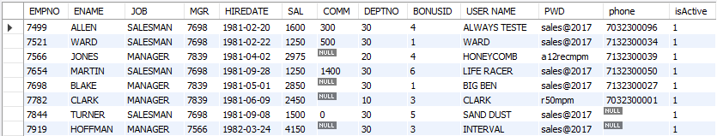
select - where
SELECT * FROM emp WHERE job = 'MANAGER' OR job = 'SALESMAN';
READ
FROM
WHERE
SELECT
identifier.job = 'MANAGER' or identifier.job = 'SALESMAN'
output
emp
identifier.*

Slide 212
combining and & or - where
Note:
AND has higher precedence than OR.
SELECT * FROM andor WHERE ename = 'saleel' AND city = 'pune' OR city = 'baroda';
SELECT * FROM andor WHERE ename = 'saleel' AND (city = 'pune' OR city = 'baroda');
SELECT ename, job, comm FROM emp WHERE comm = 0 OR comm IS NULL AND job = 'CLERK';
SELECT ename, job, comm FROM emp WHERE (comm = 0 OR comm IS NULL) AND job = 'CLERK';
EXPLAIN ANALYZE SELECT * FROM emp WHERE job = 'salesman' OR job = 'manager' AND sal > 2000;

Slide 213
select - where
SELECT A₁, A₂, A₃, . . . FROM r₁, r₂, r₃, . . . [ WHERE P ]
What will be the output of the following statement?
SELECT "Hello" # "World " FROM dual;
SELECT 10 + 10 as Result FROM dual WHERE False;
SELECT 10 + 10 as Result FROM dual WHERE True;
SELECT 10 + 10 as Result FROM dual WHERE 10 - 10;
SELECT 10 + 10 as Result FROM dual WHERE 10 - 0;
SELECT 10 + 10 as Result FROM dual WHERE 10 - 30;
SELECT '5' * '5' as Result FROM dual;
SELECT 5 * 5 - '-5' as Result FROM dual;

Slide 214
SELECT * FROM emp WHERE comm IS UNKNOWN;
SELECT * FROM emp WHERE comm IS NOT UNKNOWN;
operand IS [NOT] NULL
boolean_ predicate:
IS [NOT] NULL
| expr <=> null
is null / is not null
"IS NULL" is the keyword that performs the Boolean comparison. It returns true if the supplied value is NULL and false if the supplied value is not NULL.
“IS NOT NULL" is the keyword that performs the Boolean comparison. It returns true if the supplied value is not NULL and false if the supplied value is null.
Note:
IS UNKNOWN is synonym of IS NULL.
IS NOT UNKNOWN is synonym of IS NOT NULL.

Slide 215
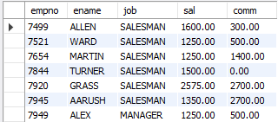
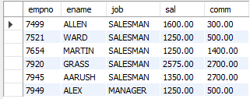
is null / is not null
Remember:
SELECT * FROM emp WHERE comm = NULL; # will return Empty set
SELECT empno, ename, job, sal, comm FROM emp WHERE comm IS NOT NULL;
SELECT empno, ename, job, sal, comm FROM emp WHERE comm IS NOT UNKNOWN;
SELECT empno, ename, job, sal, comm FROM emp WHERE comm is TRUE;

Slide 216
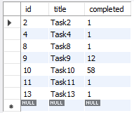
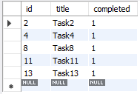
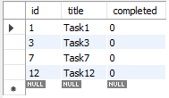
select – boolean
BOOL and BOOLEAN are synonym of TINYINT(1)
A value of zero is considered false. Nonzero values are considered true.
SELECT true, false, TRUE, FALSE, True, False;
SELECT * FROM tasks WHERE completed;
SELECT * FROM tasks WHERE completed is True;
SELECT * FROM tasks WHERE completed = 1;
SELECT * FROM tasks WHERE completed = True;
SELECT * FROM tasks WHERE NOT completed;
SELECT * FROM tasks WHERE completed is False;
SELECT * FROM tasks WHERE completed = 0;
SELECT * FROM tasks WHERE completed = False;

Slide 217
select – boolean
BOOL and BOOLEAN are synonym of TINYINT(1)
A value of zero is considered false. Nonzero values are considered true.
SELECT true, false, TRUE, FALSE, True, False;
What will be the result of the query below?
SELECT * FROM emp WHERE 1;
SELECT * FROM emp WHERE True;
SELECT * FROM emp WHERE 0;
SELECT * FROM emp WHERE False;
SELECT * FROM emp WHERE ename = '' OR 0;
SELECT * FROM emp WHERE ename = '' OR 1;
SELECT * FROM emp WHERE ename = '' OR 1 = 1;
SELECT * FROM emp WHERE ename = 'smith' OR True;
SELECT * FROM emp WHERE ename = 'smith' AND True;
SELECT * FROM emp WHERE ename IN('smith', True);
SELECT * FROM emp WHERE ename = 'smith' OR False;
SELECT * FROM emp WHERE ename = 'smith' AND False;
SELECT * FROM emp WHERE ename IN('smith', False);

Slide 218
READ
FROM
WHERE
SELECT
identifier.state IN ('VT', 'NH', . . .)
output
states
identifier.*
predicate:
expr [NOT] IN (expr1, expr2, . . . )
| expr [NOT] IN (subquery)
in
The IN statement is used in a WHERE clause to choose items from a set. The IN operator allows you to determine if a specified value matches any value in a set of values or value returned by a subquery.
SELECT . . . FROM r₁ WHERE (
state = 'VT' OR
state = 'NH' OR
state = 'ME' OR
state = 'MA' OR
state = 'CT' OR
state = 'RI'
);
SELECT . . . FROM r₁ WHERE state IN ('VT', 'NH', 'ME', 'MA', 'CT', 'RI');
SELECT . . . FROM r₁ WHERE state IN (SELECT . . . );

Slide 219
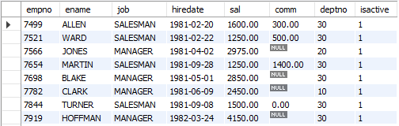
in
syntax
column | expression IN ( v1, v2, v3, . . . )
column | expression IN (subquery)
Remember:
If a value in the column or the expression is equal to any value in the list, the result of the IN operator is TRUE.
The IN operator is equivalent to multiple OR operators.
To negate the IN operator, you use the NOT IN operator.
SELECT empno, ename, job, hiredate, sal, comm, deptno, isactive FROM emp WHERE job IN ('salesman', 'manager');

Slide 220
in
IN
Remember:
On the left side of the IN() predicate, the row constructor contains only column references.
On the right side of the IN() predicate, there is more than one row constructor.
What will be the result of the query below?
SELECT * FROM emp WHERE deptno IN (10);
SELECT * FROM emp WHERE deptno IN (10, 20);
SELECT * FROM emp WHERE False IN (10, 20, 0);
SELECT * FROM emp WHERE True IN (10, 20, 1);
SELECT * FROM emp WHERE 10 IN (10, 20);
SELECT * FROM emp WHERE 7788 IN (empno, mgr); ←
SELECT * FROM emp WHERE 1 IN (10, 20, True, False);
SELECT * FROM emp WHERE deptno IN (10, 20) OR True;
SELECT * FROM emp WHERE deptno IN (10, 20) AND True;
SELECT * FROM emp WHERE deptno IN (SELECT deptno FROM dept);
SELECT * FROM emp WHERE deptno IN (SELECT deptno FROM dept WHERE dname='accounting');
SELECT * FROM emp WHERE deptno IN (TABLE deptno); # ERROR 1241 (21000): Operand should contain 1 column(s)

Slide 221
READ
FROM
WHERE
SELECT
output
emp
identifier.sal BETWEEN
1000 and 3000
identifier.*
predicate:
expr [NOT] BETWEEN expr1 AND expr2
between
The BETWEEN operator is a logical operator that allows you to specify a range to test.

Slide 222
between
syntax
WHERE salary BETWEEN ( 20000 AND 30000 ) – Illegal
column | expression BETWEEN start_expression AND end_expression
Remember:
The BETWEEN operator returns TRUE if the expression to test is greater than or equal to the value of the start_expression and less than or equal to the value of the end_expression.
You can use the greater than or equal to (>=) and less than or equal to (<=) to substitute the BETWEEN operator.
Note:
if any input to the BETWEEN or NOT BETWEEN is NULL, then the result is UNKNOWN.
e.g.
SELET empno, ename, job, hiredate, sal, comm, deptno, isactive FROM emp WHERE sal BETWEEN 1000 AND NULL;
SELECT * FROM salespeople WHERE FORMAT(comm, 2) > 0.1 AND FORMAT(comm, 2) < 0.26;

Slide 223
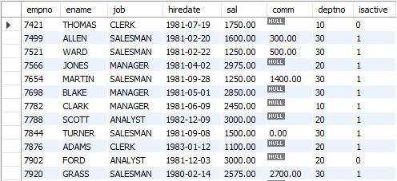
between
SELECT empno, ename, job, hiredate, sal, comm, deptno, isactive FROM emp WHERE sal BETWEEN 1000 AND 3000;

Slide 224
READ
FROM
WHERE
SELECT
output
identifier.ename LIKE 'a%'
identifier.*
emp
predicate:
expr [NOT] LIKE expr [ESCAPE char]
like
The LIKE operator is a logical operator that tests whether a string contains a specified pattern or not.

Slide 225
like - string comparison functions
syntax
column | expression LIKE 'pattern' [ESCAPE escape_character]
Remember:
% matches any number of characters, even zero characters.
_ matches exactly one character.
If we use default escape character '\', then don’t use ESCAPE keyword.
Note:
The ESCAPE keyword is used to escape pattern matching characters such as the (%) percentage and underscore (_) if they form part of the data.
If you do not specify the ESCAPE character, \ is assumed.

Slide 226
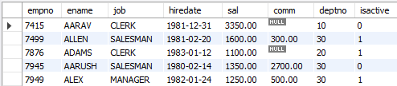
like
SELECT empno, ename, job, hiredate, sal, comm, deptno, isactive FROM emp WHERE ename LIKE 'a%';

Slide 227
like
What will be the result of the query below?
SELECT * FROM emp WHERE ename LIKE 's%';
SELECT * FROM emp WHERE 'saleel' LIKE 's%';
SELECT * FROM emp WHERE True LIKE '1';
SELECT * FROM emp WHERE True LIKE '1%';
SELECT * FROM emp WHERE True LIKE 001;
SELECT * FROM emp WHERE True LIKE 100;
SELECT * FROM emp WHERE False LIKE 100 OR 0;
SELECT * FROM emp WHERE False LIKE 0 AND 1;

Slide 228
READ
FROM
GROUP BY
SELECT
output
identifier.job
AVG(sal), SUM(sal), MAX(sal), MIN(sal), COUNT(*)
emp
aggregate functions
SUM, AVG, MAX, MIN, COUNT, and GROUP_CONCAT
SELECT . . . . . FROM table_name WHERE <condition> / GROUP BY column_name
this is invalid
SET SQL_MODE = ' ';
SET SQL_MODE = IGNORE_SPACE;
SUM(colNM) / AVG(colNM) / MAX(colNM)
MIN(colNM) / COUNT(*) / COUNT(colNM)
Remember:
None of the below two queries get executed successfully. The reason is that a condition in a WHERE clause cannot contain any aggregate function (or group function) without a subquery!
SELECT empno, ename, sal, deptno FROM emp WHERE sal = MAX(sal); #error
SELECT empno, ename, sal, deptno FROM emp WHERE MAX(sal) = sal; #error

Slide 229
aggregate functions
Remember:
There are 3 places where aggregate functions can appear in a query.
in the SELECT-LIST/FIELD-LIST (the items before the FROM clause).
in the ORDER BY clause.
in the HAVING clause.
Note:
The aggregate functions allow you to perform the calculation of a set of rows and return a single value.
The WHERE clause cannot refer to aggregate functions. e.g. WHERE SUM(sal) = 5000 # Invalid, Error
The HAVING clause can refer to aggregate functions. e.g. HAVING SUM(sal) = 5000 # Valid, No Error
Nesting of aggregate functions are not allowed.
e.g.
SELECT MAX(COUNT(*)) FROM emp GROUP BY deptno;
Blank space between aggregate functions like (SUM, MIN, MAX, COUNT) are not allowed.
e.g.
SELECT SUM (sal) FROM emp;
The GROUP BY clause is often used with an aggregate function to perform calculation and return a single value for each subgroup.

Slide 230
aggregate functions
Things to… Remember:
TODO
AVG([DISTINCT] expr)
If there are no matching rows, AVG() returns NULL.
AVG() may take a numeric argument, and it returns a average of non-NULL values.
e.g.
SELECT AVG(1) "R1";
SELECT AVG(NULL) "R1";
SELECT AVG(1) "R1" WHERE True;
SELECT AVG(1) "R1" WHERE False;
SELECT AVG(1) "R1" FROM emp;
SELECT AVG(sal) "R1" FROM emp WHERE empno = -1;
SELECT AVG(sal) "Avg Salary" FROM emp;
SELECT job, AVG(sal) "Avg Salary" FROM emp GROUP BY job;

Slide 231
aggregate functions
Things to… Remember:
TODO
SUM([DISTINCT] expr)
If there are no matching rows, SUM() returns NULL.
SUM() may take a numeric argument , and it returns a sum of non-NULL values.
e.g.
SELECT SUM(1) "R1";
SELECT SUM(NULL) "R1";
SELECT SUM(2 + 2 * 2);
SELECT SUM(1) "R1" WHERE True;
SELECT SUM(1) "R1" WHERE False;
SELECT SUM(1) "R1" FROM emp;
SELECT SUM(sal) "R1" FROM emp WHERE empno = -1;
SELECT SUM(sal) "Total Salary" FROM emp;
SELECT job, SUM(sal) "Total Salary" FROM emp GROUP BY job;

Slide 232
aggregate functions
Things to… Remember:
TODO
SUM([DISTINCT] expr)
If there are no matching rows, SUM() returns NULL.
SUM() may take a numeric argument , and it returns a sum of non-NULL values.
r = { -2, 1, 2, -1, 3, -2, 1, 2, 1 }
SELECT SUM(c1) "R1" FROM r;
SELECT SUM(IF(c1 >= 0, c1, NULL)) FROM r;
SELECT SUM(IF(c1 < 0, c1, NULL)) FROM r;
SELECT custId, type, amount, CASE type WHEN 'd' THEN amount WHEN 'c' THEN amount * -1 END amount FROM transactions;

Slide 233
aggregate functions
Things to… Remember:
TODO
MAX([DISTINCT] expr)
If there are no matching rows, MAX() returns NULL.
MAX() may take a string, number, and date argument, and it returns a maximum of non-NULL values.
e.g.
SELECT MAX(1) "R1";
SELECT MAX(NULL) "R1";
SELECT MAX('VIKAS');
SELECT MAX(1) "R1" WHERE True;
SELECT MAX(1) "R1" WHERE False;
SELECT MAX(1) "R1" FROM emp;
SELECT MAX(sal) "R1" FROM emp WHERE empno = -1;
SELECT MAX(sal) "Maximum Salary" FROM emp;
SELECT job, MAX(sal) "Maximum Salary" FROM emp GROUP BY job;

Slide 234
aggregate functions
Things to… Remember:
TODO
MIN([DISTINCT] expr)
If there are no matching rows, MIN() returns NULL.
MIN() may take a string, number, and date argument, and it returns a minimum of non-NULL values.
e.g.
SELECT MIN(1) "R1";
SELECT MIN(NULL) "R1";
SELECT MIN(1) "R1" WHERE True;
SELECT MIN(1) "R1" WHERE False;
SELECT MIN(1) "R1" FROM emp;
SELECT MIN(sal) "R1" FROM emp WHERE empno = -1;
SELECT MIN(sal) "Minimum Salary" FROM emp;
SELECT job, MIN(sal) "Minimum Salary" FROM emp GROUP BY job;

Slide 235
aggregate functions
Things to… Remember:
TODO
COUNT([DISTINCT] expr)
If there are no matching rows, COUNT() returns 0.
Returns a count of the number of non-NULL values.
COUNT(*) is somewhat different in that it returns a count of the number of rows retrieved, whether or not they contain NULL values.
COUNT (*) is a special implementation of the COUNT function that returns the count of all the rows in a specified table.
COUNT (*) also considers Nulls and duplicates.
e.g.
SELECT COUNT(*) "R1";
SELECT COUNT(NULL) "R1";
SELECT COUNT(*) "R1" WHERE True;
SELECT COUNT(*) "R1" WHERE False;
SELECT COUNT(0) FROM emp;
SELECT COUNT(1) FROM emp;
SELECT COUNT(*) FROM emp WHERE empno = -1;
SELECT COUNT(comm) "R1" FROM emp;
SELECT job, COUNT(*) "R1" FROM emp GROUP BY job;

Slide 236
aggregate functions
Things to… Remember:
TODO
GROUP_CONCAT([DISTINCT] expr
[ORDER BY {unsigned_integer | col_name | expr} [ASC | DESC] [,col_name . . .]]
[SEPARATOR str_val])
e.g.
SELECT job, GROUP_CONCAT(ename) FROM emp GROUP BY job;
SELECT deptno, GROUP_CONCAT(ename) FROM emp group BY deptno;
SELECT job, CONCAT(GROUP_CONCAT(ename),' (', COUNT(*), ')') FROM emp GROUP BY job;
SELECT job, CONCAT(GROUP_CONCAT(sal),' (', MAX(sal), ')') FROM emp GROUP BY job;
SELECT job, CONCAT(GROUP_CONCAT(sal),' (', SUM(sal), ')') FROM emp GROUP BY job;

Slide 237

SET SQL_MODE = '';
SET SQL_MODE = 'ONLY_FULL_GROUP_BY';
^{G}A_{1,} A_{2,} . . ., A_{n,} ^{G}F₁(A₁), F₂(A₂), . . ., F_{m}(A_{m}) ^{(r)}
group by clause
Remember:
Standard SQL does not allow you to use an ALIAS in the GROUP BY clause, however, MySQL supports this.
Note:
DISTINCT (if used outside an aggregation function) that is superfluous.
e.g.
SELECT DISTINCT COUNT(ename) FROM emp;

Slide 238
select - group by
Columns selected for output can be referred to in ORDER BY and GROUP BY clauses using column names, column aliases, or column positions. Column positions are integers and begin with 1
If you use GROUP BY, output rows are sorted according to the GROUP BY columns as if you had an ORDER BY for the same columns. To avoid the overhead of sorting that GROUP BY produces, add ORDER BY NULL.
If a query includes GROUP BY but you want to avoid the overhead of sorting the result, you can suppress sorting by specifying ORDER BY NULL.
For example:
SELECT job, COUNT(*) FROM emp GROUP BY job ORDER BY NULL;
SELECT * FROM emp ORDER BY FIELD (job, 'MANAGER', 'SALESMAN');

Slide 239
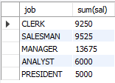
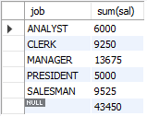
select - group by
This function's will produce a single value for an entire group or a table.
You can use GROUP BY to group values from a column, and, if you wish, perform calculations on that column.
SELECT G₁, G₂, . . . , F₁(A₁), F₂(A₂), . . . FROM r₁, r₂, r₃ . . .
[GROUP BY {G₁, G₂, . . . | expr | position}, . . . [WITH ROLLUP]]
SELECT job, SUM(sal) FROM emp GROUP BY job;
SELECT job, SUM(sal) FROM emp GROUP BY job WITH ROLLUP;
READ
FROM
GROUP BY
SELECT
job
output
identifier.job
identifier.Job, SUM(sal)
emp

Slide 240
select - group by
SET SQL_MODE = '';
SET SQL_MODE = 'ONLY_FULL_GROUP_BY';
Examples:
SELECT job, sal + 1001 FROM emp GROUP BY job;
SELECT job, COUNT(job) FROM emp GROUP BY COUNT(job); # error
SELECT job, sal + 1001 FROM emp GROUP BY sal + 1001;
SELECT ename, LENGTH(ename) R1 FROM emp GROUP BY R1;
SELECT job, SUM(sal) FROM emp GROUP BY job WITH ROLLUP;
SELECT COALESCE (job, 'Total'), SUM(sal) FROM emp GROUP BY job WITH ROLLUP;

Slide 241
select …. for update

Slide 242
select - for update
SELECT * FROM emp for UPDATE;

Slide 243
Remember:
The WHERE clause cannot refer to aggregate functions. [ WHERE SUM(sal) = 5000 # Error ]
The HAVING clause can refer to aggregate functions. [ HAVING SUM(sal) = 5000 # No Error ]
having clause
The MySQL HAVING clause is used in the SELECT statement to specify filter conditions for a group of rows. HAVING clause is often used with the GROUP BY clause. When using with the GROUP BY clause, we can apply a filter condition to the columns that appear in the GROUP BY clause.
Note:
Columns given in HAVING clause must be present in selection-list.
e.g.
SELECT COUNT(*) FROM emp HAVING deptno=10; *
SELECT deptno, COUNT(*) FROM emp GROUP BY deptno HAVING job='manager'; *
HAVING is merged with WHERE if you do not use GROUP BY or Aggregate Functions (COUNT(), . . .)
* ERROR: Unknown column '. . .' in 'having clause'

Slide 244

select - having
SELECT G₁, G₂, . . . , F₁(A₁), F₂(A₂), . . . FROM r₁, r₂, r₃ . . .
[GROUP BY {G₁, G₂, . . . | expr | position}, . . . [WITH ROLLUP]]
[ HAVING having_condition ]
SELECT COUNT(*), job FROM emp GROUP BY job HAVING COUNT(*) > 2;
READ
FROM
GROUP BY
HAVING
SELECT
identifier.job
COUNT(*) > 2
identifier.job, COUNT(*)
output
emp

Slide 245
When WHERE and HAVING clause are used together in a SELECT query with aggregate function, WHERE clause is applied first on individual rows and only rows which pass the condition is included for creating groups. Once group is created, HAVING clause is used to filter groups based upon condition specified.
difference between where and having clause

Slide 246
where and having clause
Remember:
WHERE clause can be used with - SELECT, UPDATE, and DELETE statements, where as HAVING clause can only be used with the SELECT statement.
WHERE clause filters rows before aggregation (GROUPING), where as, HAVING clause filters groups, after the aggregations are performed.
WHERE is used before the ‘GROUP BY’ clause if required and HAVING is used after the ‘GROUP BY’ clause.
Aggregate functions (SUM, MIN, MAX, AVG and COUNT) cannot be used in the WHERE clause, unless it is in a sub query contained in a WHERE or HAVING clause, whereas, aggregate functions can be used in HAVING clause.
Note:
The WHERE clause acts as a pre-filter where as HAVING clause acts as a post-filter.

Slide 247
where vs having
WHERE
VS
HAVING
WHERE | HAVING
Implemented in row operations. | Implemented in column operations.
Single row | Summarized row or group or rows.
It only fetches the data from particular rows or table according to the condition. | It only fetches the data from grouped data according to the condition.
Aggregate Functions ccannot appear in WHERE clause. | Aggregate Functions Can appear in HAVING clause.
Used with SELECT and other statements such as UPDATE, DELETE or either one of them. | Used with SELECT statement only.
Pre-filter | Post-filter
GROUP BY Comes after WHERE. | GROUP BY Comes before HAVING.

Slide 248
window function

Slide 249
window function
Use ORDER BY expr with PARTITION BY expr to see the effect of PARTITION BY expr.
RANK() OVER(PARTITION BY expr [, expr] . . . ORDER BY expr [ASC | DESC] [, expr [ASC | DESC]] . . . )
DENSE_RANK() OVER(PARTITION BY expr [, expr] . . . ORDER BY expr [ASC|DESC] [, expr [ASC | DESC]] . . . )
ROW_NUMBER() OVER([ PARTITION BY expr [, expr] . . . ORDER BY expr [ASC|DESC] [, expr [ASC | DESC]] . . . ] )
Note:
MySQL does not support these window function features.
DISTINCT syntax for aggregate functions.
Nested window functions
Window function cannot be the part of WHERE condition

Slide 250
window function- examples
FIFA / Forbes
SELECT ROW_NUMBER() OVER() R1, emp.* FROM emp;
SELECT RANK() OVER(PARTITION BY job ORDER BY sal) R1, ename, sal, job FROM emp;
SELECT DENSE_RANK() OVER(PARTITION BY job ORDER BY sal) R1, ename, sal, job FROM emp;
SELECT ordid, total, SUM(total) OVER(ORDER BY ordid) FROM ord;
SELECT * FROM (SELECT ROW_NUMBER() OVER() R1, emp.* FROM emp) d WHERE R1> (SELECT COUNT(*) - 2 FROM emp);
SELECT custId, type, amount, CASE type WHEN 'd' THEN amount WHEN 'c' THEN amount * -1 END amount FROM transactions;
SELECT year, quarter, amount, SUM(amount) OVER(PARTITION BY year ORDER BY amount) R1 FROM quarter_revenue;
SELECT custId, type, amount, SUM(CASE type WHEN 'd' THEN amount WHEN 'c' THEN amount * -1 END) OVER(PARTITION BY custID ORDER BY _id) amount FROM transactions;

Slide 251
user-defined variables

Slide 252
user-defined variables
TODO
Remember:
A user variable name can contain other characters if you quote it as a string or identifier (for example, @'my-var', @"my-var", or @`my-var`).
User-defined variables are session specific. A user variable defined by one client cannot be seen or used by other clients.
All variables for a given client session are automatically freed when that client exits.
User variable names are not case sensitive. Names have a maximum length of 64 characters.
If the value of a user variable is selected in a result set, it is returned to the client as a string.
If you refer to a variable that has not been initialized, it has a value of NULL and a type of string.
e.g. SELECT @variable_name;

Slide 253
user-defined variables
You can store a value in a user-defined variable in one statement and refer to it later in another statement. This enables you to pass values from one statement to another.
SET @variable_name = expr [, @variable_name = expr] . . .
Remember:
for SET, either = or := can be used as the assignment operator.
You can also assign a value to a user variable in statements (SELECT, …) other than SET. In this case, the assignment operator must be := and not = because latter is treated as the comparison operator =.
set @v1 = 1001, @v2 := 2, @v3 = 'Saleel';
set @v1 = 1001, @v2 = 2, @v3 := @v1 + @v2;
SELECT @v1 := MIN(sal), @v2 := MAX(SAL) FROM emp;
SELECT @v1, @v2, @v3;

Slide 254

user-defined variables
Note:
User variables are intended to provide data values. They cannot be used directly in an SQL statement as an identifier or as part of an identifier.
e.g.
SET @v1 = 'ENAME'; #WHERE ENAME IS COLUMN NAME.
SELECT @v1 FROM emp;

Slide 255
rownum
mysql> SELECT * FROM (SELECT @cnt := @cnt + 1 "R1", emp.* FROM emp, (SELECT @cnt := 0) T1) T2 WHERE "R1" > @cnt - 7;

Slide 256
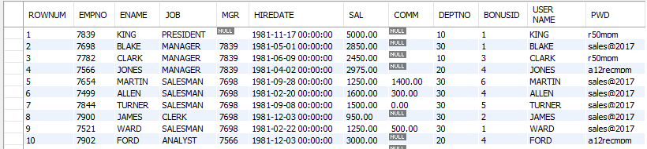
select - rownum
mysql> SET @rank = 0;
mysql> SELECT @row := @row + 1 as rownum , emp.* FROM emp;
mysql> SELECT @row := @row + 1 as rownum , emp.* FROM emp, (SELECT @row := 0) as E;
mysql> SELECT @row := @row + 1 ,E.* FROM (SELECT job, sal FROM emp GROUP BY job ORDER BY SAL DESC) E , (SELECT @row := 0) EE;

Slide 257
common sql statements mistakes
Examples:
SELECT ename, job, sal, comm FROM emp WHERE comm = NULL; #using comparison operator to check NULL
SELECT job, COUNT(job) FROM emp; #not giving group by clause
SELECT job, COUNT(job) FROM emp WHERE COUNT(job) > 4; #use of aggregate function in where clause
SELECT job, deptno, COUNT(job) FROM emp GROUP BY job; #not giving all the columns in group by clause
SELECT ename, COUNT(job) FROM emp GROUP BY ename; #grouping by a unique key
SELECT ename, sal, sal+1000 R1 FROM emp WHERE R1 > 2400; #use of alias name in where clause
SELECT ename, sal FROM emp WHERE sal BETWEEN (1000 and 4000); #use of () in between comparison operator
r1 = { col1, col2, col3 }
INSERT INTO r1 VALUSE(10, 10); #number of values are less than the number of columns in the table
INSERT INTO r1 VALUSE(10, 10, 10, 10); #number of values are more than the number of columns in the table

Slide 258
Remember:
A subquery must be enclosed in parentheses.
Use single-row operators with single-row subqueries, and use multiple-row operators with multiple-row subqueries.
If a subquery (inner query) returns a null value to the outer query, the outer query will not return any rows when using certain comparison operators in a WHERE clause.
If ORDER BY occurs within a subquery and also is applied in the outer query, the outermost ORDER BY takes precedence.
If LIMIT occurs within a subquery and also is applied in the outer query, the outermost LIMIT takes precedence.
sub-queries
A subquery is a SELECT statement within another statement.
Note:
You may use comparison operators such as <>, <, >, <=, and >= with a single row subquery.
Multiple row subquery returns one or more rows to the outer SQL statement. You may use the IN, ANY, or ALL operator in outer query to handle a subquery that returns multiple rows.

Slide 259

subqueries
A subquery is a SELECT statement within another statement.
INSERT . . . SELECT . . .
UPDATE . . . SELECT . . .
DELETE . . . SELECT . . .
CREATE TABLE . . . AS SELECT . . .
CREATE VIEW . . . AS SELECT . . .
DECLARE CURSOR . . . AS SELECT . . .
EXPLAIN SELECT . . .
Remember:
A subquery may occur in:
A SELECT clause
A FROM clause
A WHERE clause
A HAVING clause
Note:
A subquery's outer statement can be any one of:
SELECT
INSERT
UPDATE
DELETE
CREATE

Slide 260
types of subqueries
The Subquery as Scalar Operand – SELECT clause
Comparisons using Subqueries – WHERE / HAVING clause (Single row subquery)
Subqueries in the FROM Clause – INLINE VIEWS (Derived Tables)
Subqueries with ALL, ANY, IN, or SOME – WHERE / HAVING clause (Multiple row subquery)
Subqueries with EXISTS or NOT EXISTS
Row Subqueries
WITH var(param) as (SELECT) [CET] Common Table Expressions
WITH a(p1, p2, p3, p4) AS (SELECT * FROM dept) SELECT p1, p2, p3, p4 FROM a;

Slide 261
the subquery as scalar operand

Slide 262
the subquery as scalar operand
TODO
SELECT A₁, A₂, A₃, (subquery) as A₄, . . . FROM r
Remember:
A scalar subquery is a subquery that returns exactly one column value from one row.
A scalar subquery is a simple operand, and you can use it almost anywhere a single column value is legal.
Note:
If the subquery returns 0 rows then the value of scalar subquery expression is null.
if the subquery returns more than one row then MySQL returns an error.
Think:
SELECT (SELECT 1, 2); #error
SELECT (SELECT ename, sal FROM emp); #error
SELECT (SELECT * FROM emp); #error
SELECT (SELECT NULL + 1);
SELECT ename, (SELECT dname FROM dept WHERE emp.deptno = dept.deptno) R1 FROM emp ;

Slide 263


the subquery as scalar operand
e.g.
SELECT (SELECT stdprice FROM price WHERE prodid = 100890 AND enddate IS NOT NULL) AS "Standard Price", (SELECT minprice FROM price WHERE prodid = 100890 AND enddate IS NOT NULL) AS "Minimum Price";
SELECT (SELECT stdprice FROM price WHERE prodid = 100890 AND enddate IS NOT NULL) - (SELECT minprice FROM price WHERE prodid = 100890 AND enddate IS NOT NULL) AS "Price Difference";

Slide 264
subquery in the from clause

Slide 265

subqueries in the from clause
TODO
SELECT A₁, A₂, A₃, (subquery) as A₄, . . . FROM (subquery) [AS] name . . .
Note:
Every table in a FROM clause must have a name, therefore the [AS] name clause is mandatory.
SET @x :=0;
SELECT * FROM (SELECT @x := @x + 1 as R1, emp.* FROM emp) DT WHERE R1 = 5;
SELECT * FROM (SELECT @cnt := @cnt + 1 R1, MOD(@cnt,2) R2, emp.* FROM emp, (SELECT @cnt:=0) DT1 ) DT2 WHERE R2 = 0;
SELECT MIN(R1) FROM (SELECT COUNT(job) R1 FROM emp GROUP BY job) DT;
SELECT MAX(R1) FROM (SELECT COUNT(*) R1 FROM actor_movie GROUP BY actorid) DT
SELECT AVG(SUM(column1)) FROM t1 GROUP BY column1; //ERROR
SELECT AVG(sum_column1)
FROM (SELECT SUM(column1) AS sum_column1
FROM t1 GROUP BY column1) AS t1;

Slide 266
comparisons using subquery

Slide 267
comparisons using subqueries
Comparison Operators like : =, !=/<>, >, >=, <, <= ,<=>
TODO
SELECT A₁, A₂, A₃, (subquery) as A₄, . . . FROM r WHERE p = (subquery)
Remember:
A subquery can be used before or after any of the comparison operators.
The subquery can return at most one value.
The value can be the result of an arithmetic expression or a function.
SELECT * FROM emp WHERE deptno = (SELECT 5 + 5);
SELECT * FROM emp WHERE sal = (SELECT MAX(sal) FROM emp);
SELECT MAX(sal) FROM emp WHERE sal < (SELECT MAX(sal) FROM emp);
SELECT * FROM emp WHERE sal > (SELECT sal FROM emp GROUP BY sal ORDER BY sal DESC limit 3, 1) ORDER BY sal DESC;
Following statements will raise an error.
SELECT * FROM emp WHERE deptno = (SELECT deptno FROM dept WHERE deptno IN(10, 20));

Slide 268

comparisons using subqueries
movie : (movieid, name, release_date)
actor : (actorid, name)
actor_movie : (actorid, movieid)
Actor
Movie
Movie _Actor
SELECT a.actorid, a.name FROM actor a, actor_movie am WHERE a.actorid = am.actorid GROUP BY am.actorid HAVING COUNT(*) = (SELECT MAX(R1) FROM (SELECT COUNT(*) "R1" FROM actor_movie GROUP BY actorid) M);

Slide 269
Remember:
When used with a subquery, the word IN is an alias for =ANY
NOT IN is not an alias for <>ANY, but for <>ALL
subquery with in, all, any, some

Slide 270
subqueries with in, all, any, some
operand comparison_operator ANY (subquery)
operand IN (subquery)
operand comparison_operator SOME (subquery)
operand comparison_operator ALL (subquery)
The word SOME is an alias for ANY.
The ANY keyword, which must follow a comparison operator, means return TRUE if the comparison is TRUE for ANY of the values in the column that the subquery returns.
The word ALL, which must follow a comparison operator, means return TRUE if the comparison is TRUE for ALL of the values in the column that the subquery returns.
IN and =ANY are not synonyms when used with an expression list. IN can take an expression list, but = ANY cannot.
SELECT * FROM emp WHERE deptno IN (5+5, 10+10);
SELECT * FROM emp WHERE job =ANY (SELECT job FROM emp WHERE deptno IN(10, 20)) ;
SELECT * FROM emp WHERE deptno =ANY (10, 20); //error

Slide 271
subqueries with in, all, any, some
TODO
SELECT A₁, A₂, A₃, (subquery) as A₄, . . . FROM (subquery) [ AS ] Alias WHERE p IN (subquery)
SELECT A₁, A₂, A₃, (subquery) as A₄, . . . FROM (subquery) [ AS ] Alias WHERE p ANY (subquery)
SELECT A₁, A₂, A₃, (subquery) as A₄, . . . FROM (subquery) [ AS ] Alias WHERE p ALL (subquery)
Remember:
SELECT * FROM emp WHERE deptno = SELECT deptno FROM dept WHERE dname = 'SALES'; // error
SELECT * FROM emp WHERE deptno IN SELECT deptno FROM dept WHERE dname = 'SALES'; // error
SELECT * FROM emp WHERE deptno IN SELECT * FROM dept WHERE dname = 'SALES'; // error

Slide 272


any / some
"x = ANY (...)": The value must match one or more values in the list to evaluate to TRUE.
"x != ANY (...)": The value must not match one or more values in the list to evaluate to TRUE.
"x > ANY (...)": The value must be greater than the smallest value in the list to evaluate to TRUE.
"x < ANY (...)": The value must be smaller than the biggest value in the list to evaluate to TRUE.
"x >= ANY (...)": The value must be greater than or equal to the smallest value in the list to evaluate to TRUE.
"x <= ANY (...)": The value must be smaller than or equal to the biggest value in the list to evaluate to TRUE.

Slide 273


all
"x = ALL (...)": The value must match all the values in the list to evaluate to TRUE.
"x != ALL (...)": The value must not match any values in the list to evaluate to TRUE.
"x > ALL (...)": The value must be greater than the biggest value in the list to evaluate to TRUE.
"x < ALL (...)": The value must be smaller than the smallest value in the list to evaluate to TRUE.
"x >= ALL (...)": The value must be greater than or equal to the biggest value in the list to evaluate to TRUE.
"x <= ALL (...)": The value must be smaller than or equal to the smallest value in the list to evaluate to TRUE.

Slide 274
all
empty table
The expression is TRUE, if table T2 is empty.
SELECT * FROM EMP WHERE DEPTNO >ALL (SELECT C1 FROM T2) // This statement will return all rows from EMP table.

Slide 275
subqueries with in, all, any, some
You can use a subquery after a comparison operator, followed by the keyword IN, ALL, ANY, or SOME.
SELECT * FROM emp WHERE deptno IN (SELECT deptno FROM emp WHERE deptno = 10 OR deptno = 20);
SELECT * FROM emp WHERE sal >ALL (SELECT sal FROM emp WHERE ename = 'ADAMS' OR ename = 'TURNER');
SELECT * FROM emp WHERE sal >ANY (SELECT sal FROM emp WHERE ename = 'ADAMS' OR ename = 'TURNER');
SELECT * FROM emp WHERE sal >SOME (SELECT sal FROM emp WHERE ename = 'ADAMS' OR ename = 'TURNER');
SELECT * FROM d1 WHERE c1 not in (SELECT min(c1) FROM d1 GROUP BY deptno, dname, loc, walletid) ORDER BY deptno;

Slide 276
SELECT * FROM emp WHERE EXISTS (SELECT 1);
subquery with exists or not exists

Slide 277
subqueries with exists or not exists
The EXISTS operator tests for the existence of rows in the results set of the subquery. If a subquery row value is found, EXISTS subquery returns TRUE and in this case NOT EXISTS subquery will return FALSE.
SELECT A₁, A₂, A₃, A₄, . . . FROM r WHERE [NOT] EXISTS (subquery)
The records will be displayed from outer SELECT statement….
SELECT * FROM emp WHERE EXISTS (SELECT * FROM dept WHERE emp.deptno = dept.deptno);
SELECT * FROM dept WHERE NOT EXISTS (SELECT deptno FROM emp WHERE emp.deptno = dept.deptno);
SELECT * FROM emp m WHERE EXISTS (SELECT * FROM emp e WHERE e.mgr = m.empno);
SELECT * FROM emp m WHERE NOT EXISTS (SELECT * FROM emp e WHERE e.mgr = m.empno);
SELECT * FROM dept WHERE deptno IN (SELECT * FROM emp WHERE emp.deptno = dept.deptno);
SELECT * FROM dept WHERE deptno NOT IN (SELECT * FROM emp WHERE emp.deptno = dept.deptno);
SELECT * FROM emp f WHERE NOT EXISTS (SELECT * FROM emp m WHERE f.deptno = m.deptno AND gender = 'm');
SELECT * FROM emp m WHERE NOT EXISTS (SELECT true FROM emp f WHERE m.deptno = f.deptno AND f.gender = 'f');

Slide 278

"Live as if you were to die tomorrow.
Learn as if you were to live forever"

